Slide 1
This is CMO
Notes:
Thanks for inviting us to your meeting. We love introducing our sport to fellow horse people. A little history might be helpful.
1981 Cliff Pladsen, in MN, created CMO as an educational and fun game for his family while trail riding. Dave’s job moved us to MN in 1986 and we discovered CMO in 1987 or so. It was a way to meet horse people who were fun to be with and gave us (especially Dave) something to do while trail riding – a purpose. When we moved back to IN in 1991, we started the IN/IL chapter to meet those same fun people.

Slide 2
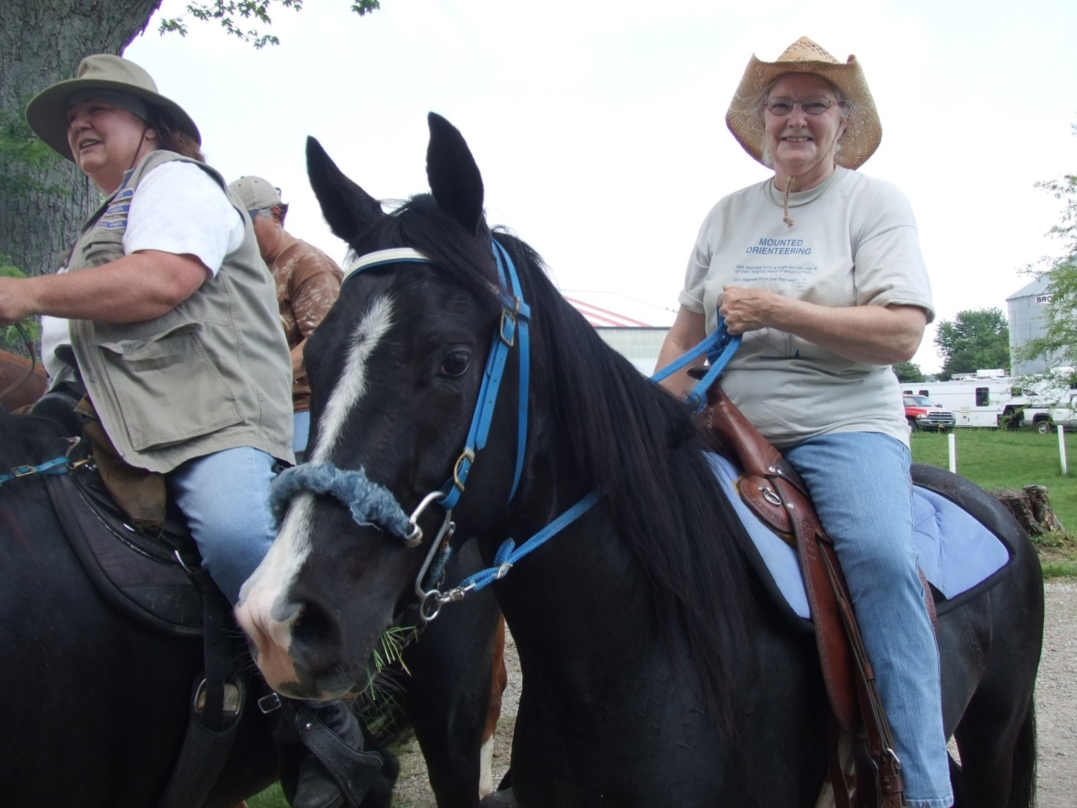
Notes:
Roxie Bank and Cecelia Wozniak came to the first IN/IL CMO in 1992 at Kankakee State Park.
John and Kathy Haas were at that first CMO in 1992, also, and are still active today. Here with their daughter, Kristin who is now bringing her daughter.
IN 2012, we celebrated our first 20 years of CMO in IN/IL. In 2022 it will be 30 years!

Slide 3
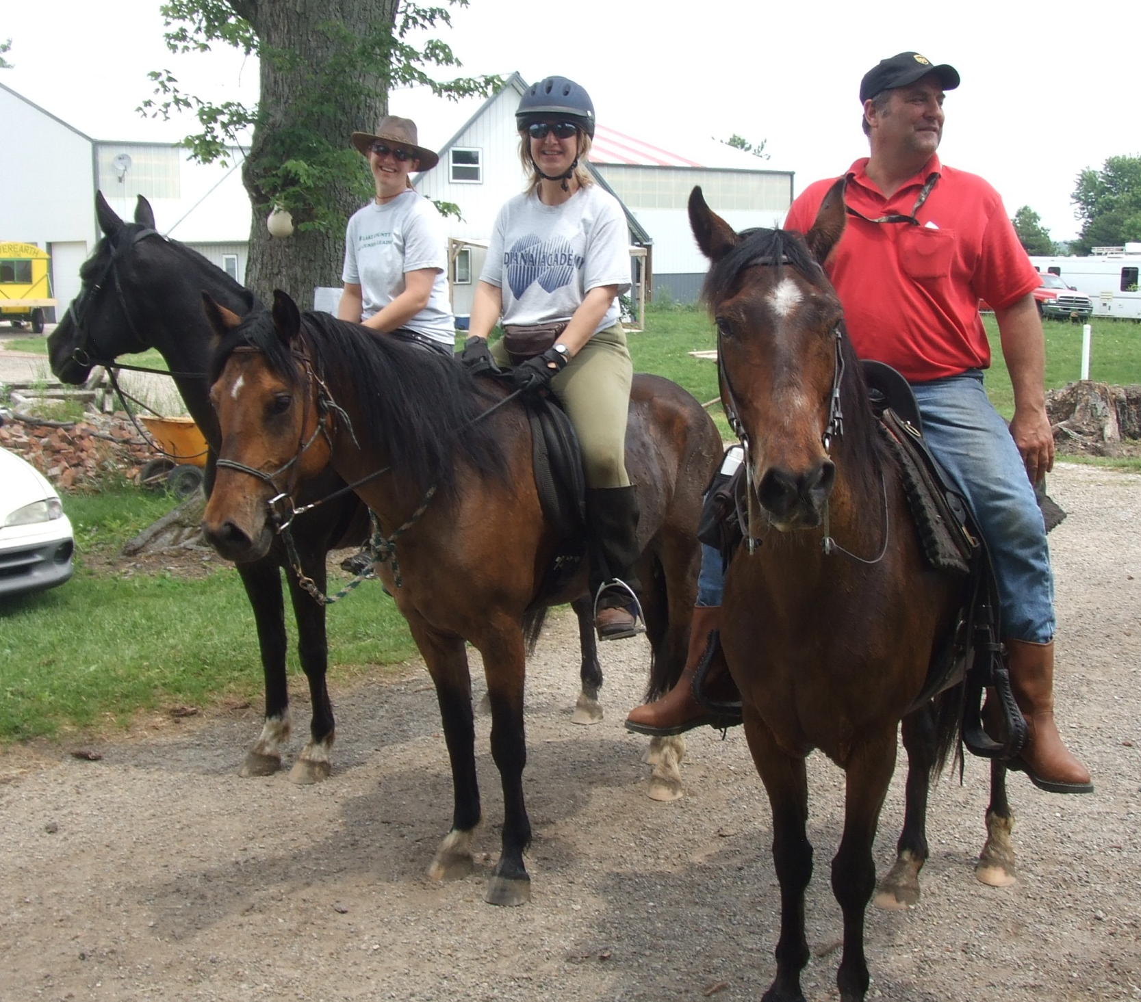

Slide 5
NACMO now
Chapters all over the country.
People of every walk of life and many occupations
People and horses of all sizes and ages compete
New chapters always welcome

Slide 6
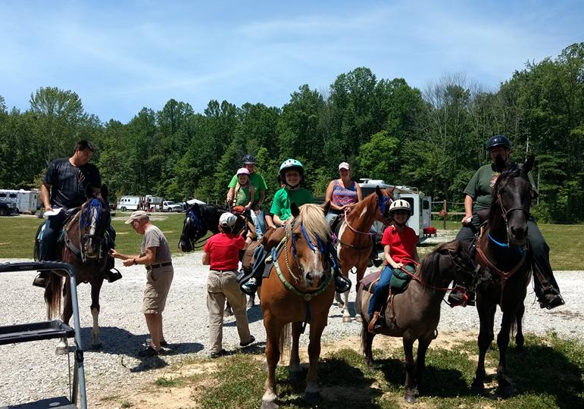
Notes:
Truly a family sport, riders ride at any pace and find as many or as few markers as they like. It is a great way to spend quality time with your family and have a purpose to your ride.

Slide 7
Notes:
Mules are popular mounts……
As are gaited horses – TWHs
Even a Percheron and 2 arabs.

Slide 9
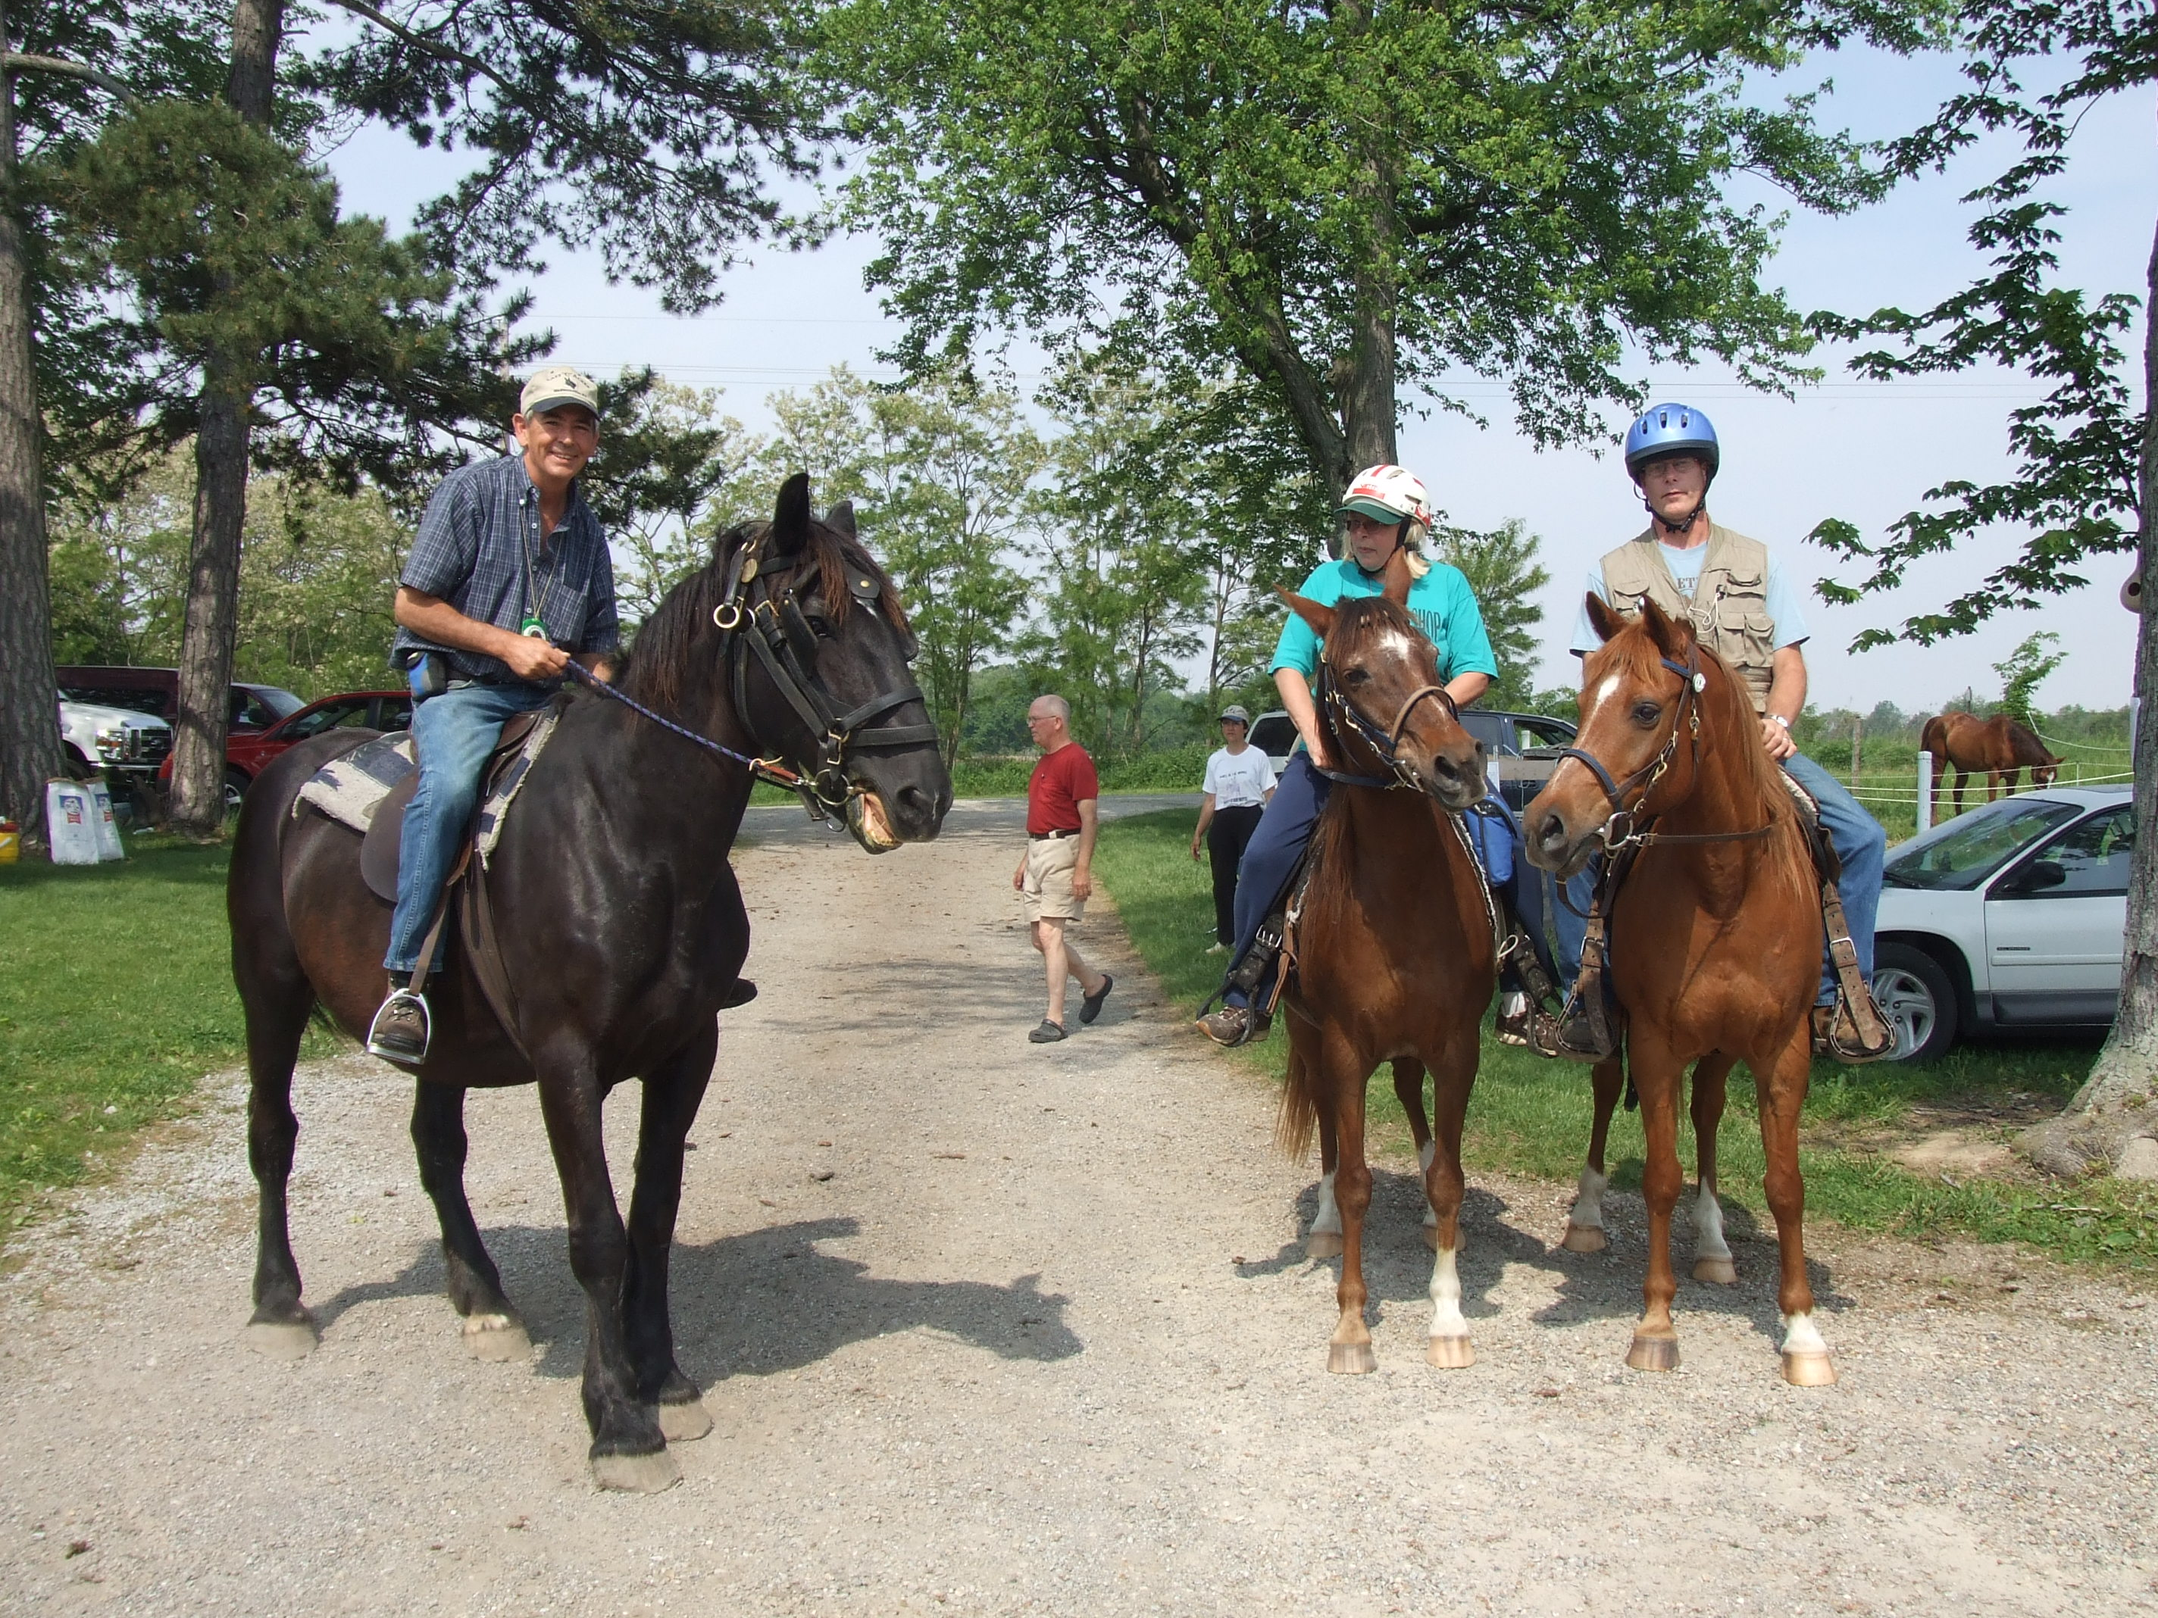

Slide 10
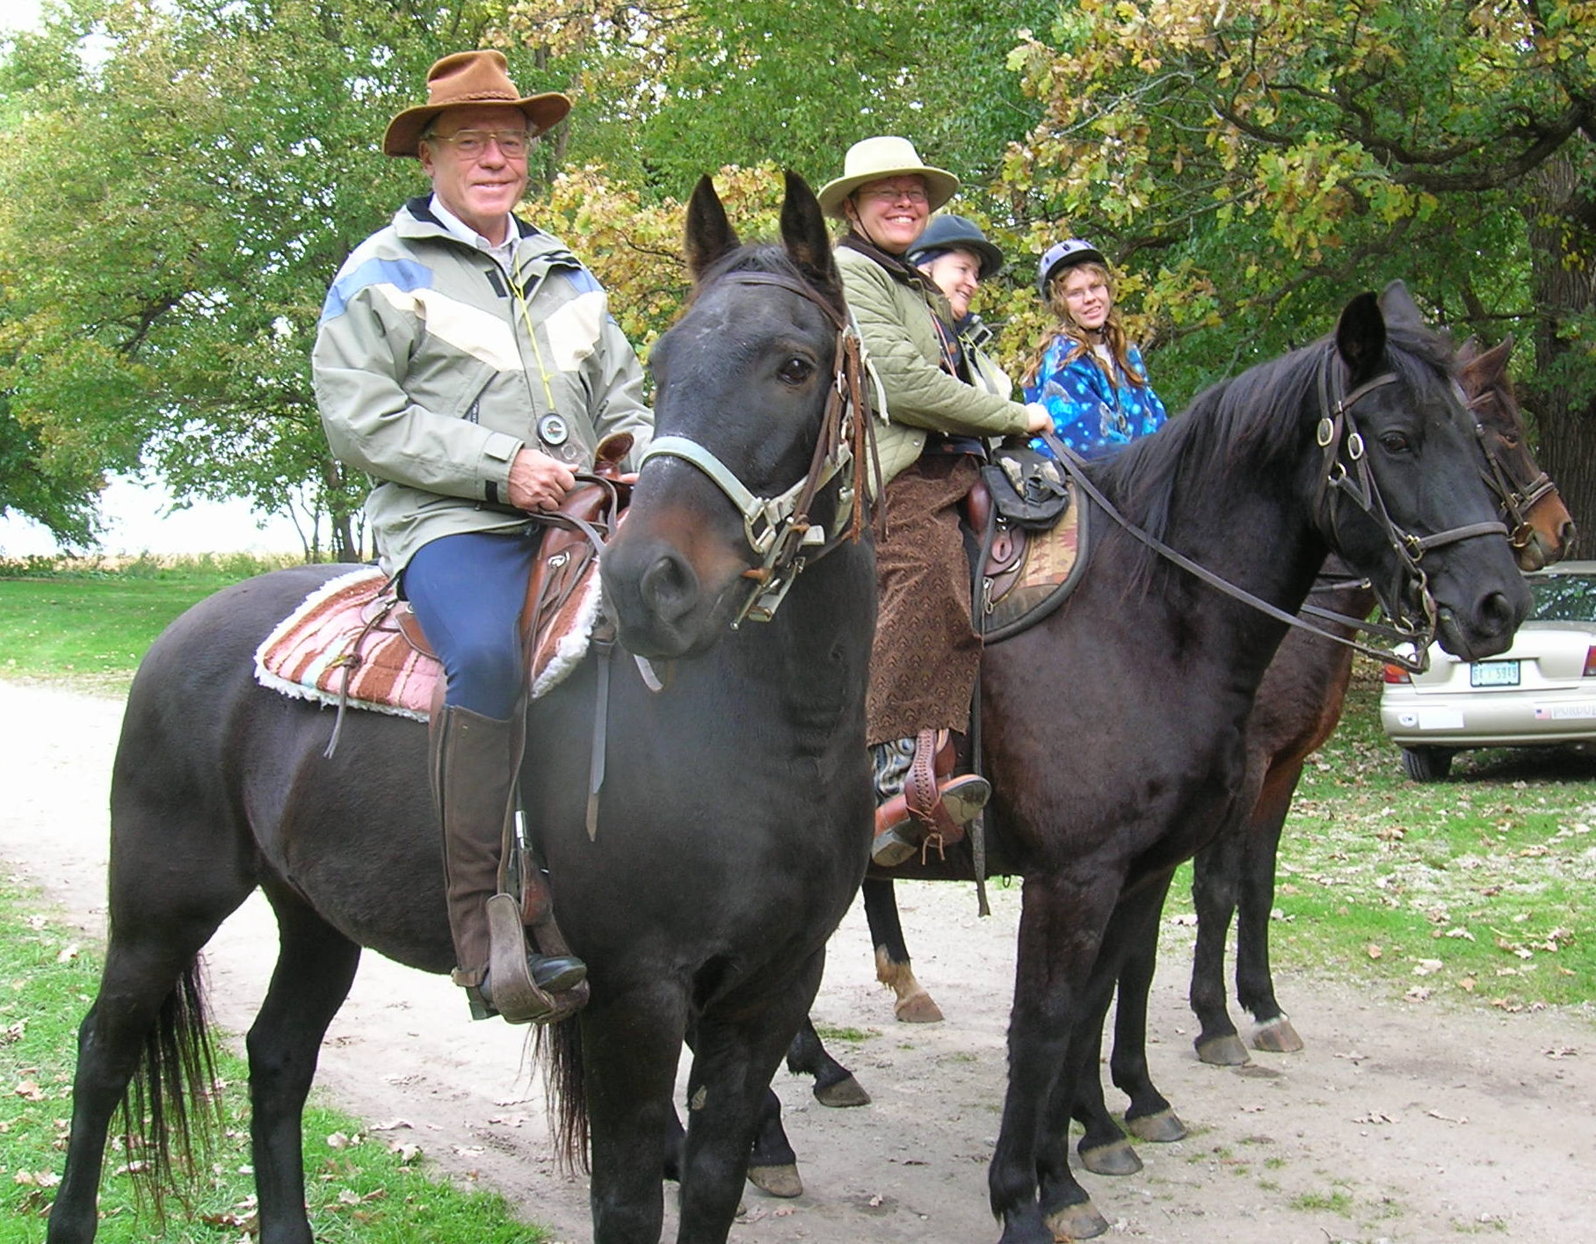
Notes:
Three generations of one family. Svenja, second from left, is here with her daughter, and her parents, who time their visits from Germany to coincide with our CMO schedule.
Even new riders, can go along – like this youngster on a lead line.
And it’s a great way for kids to develop good riding skills.

Slide 12
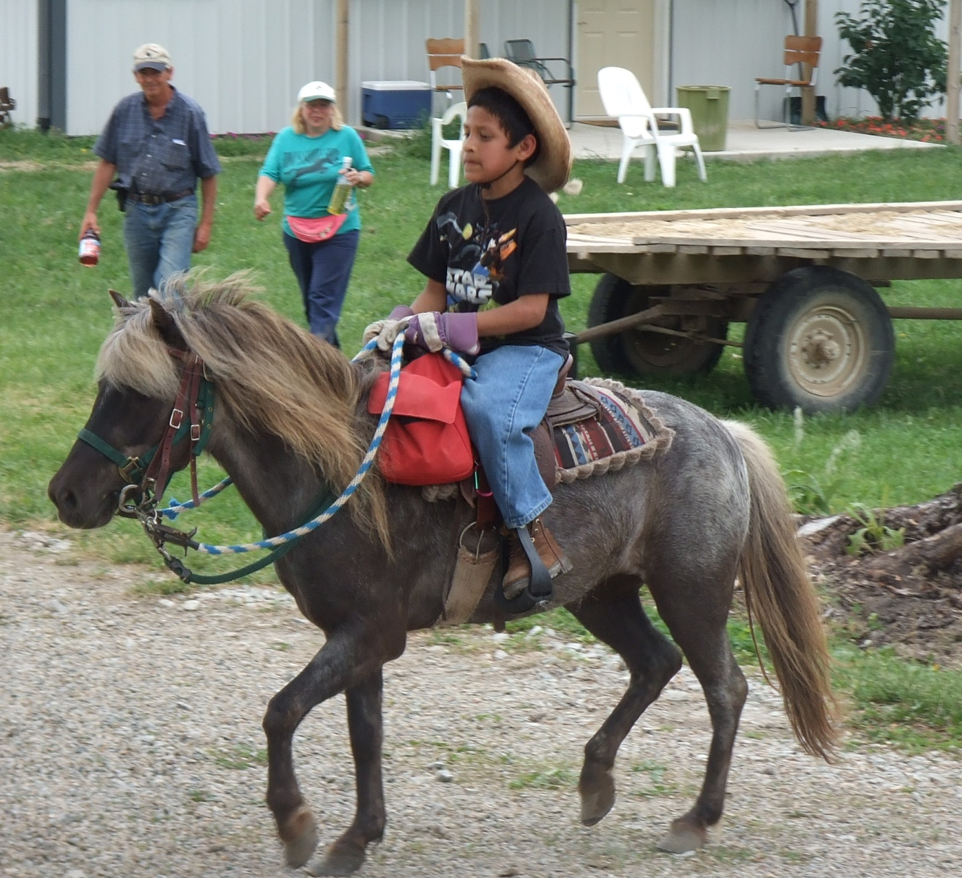

Slide 13
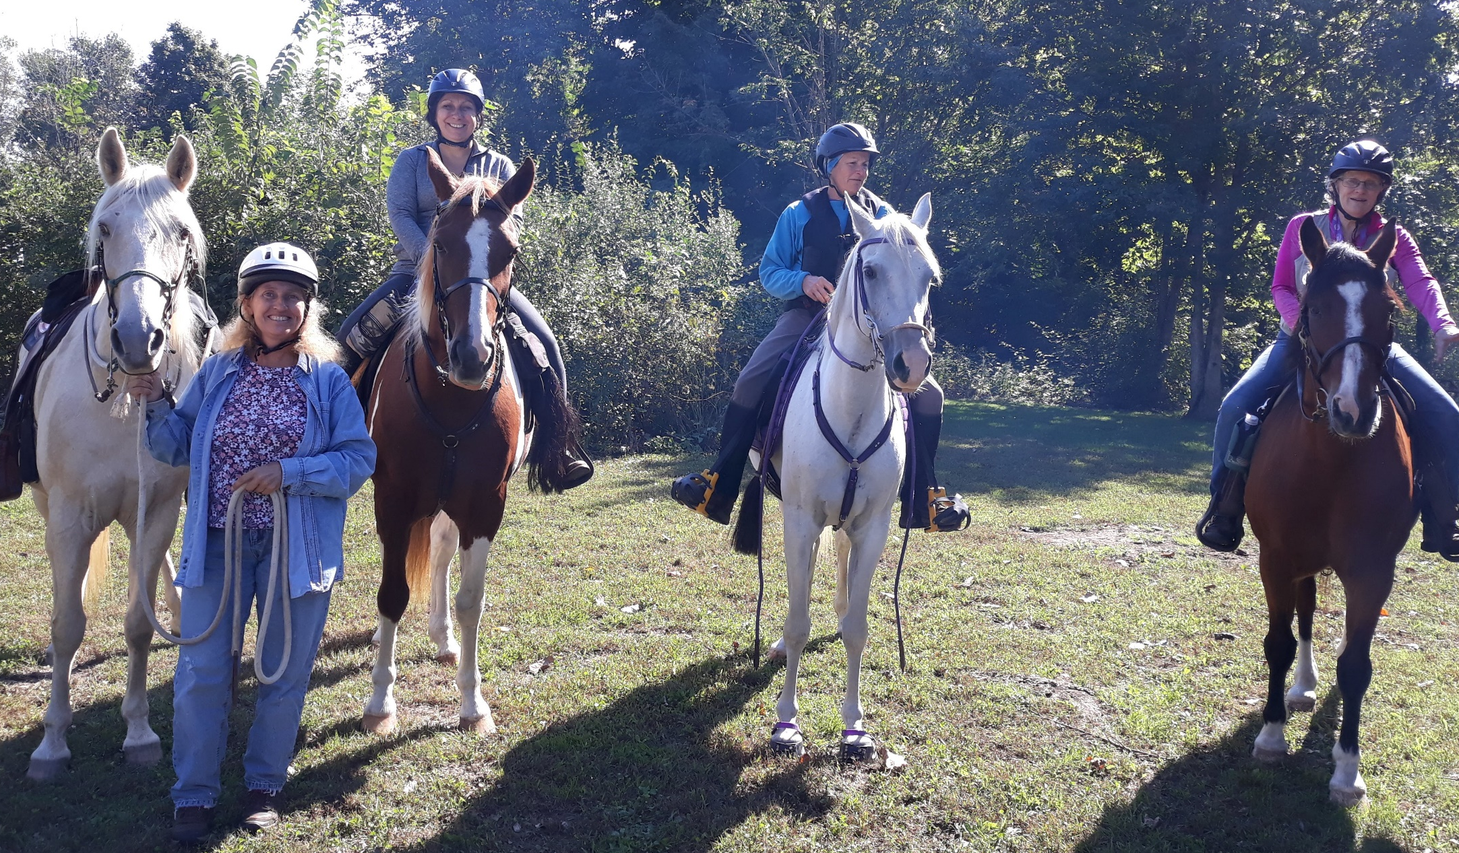
Notes:
CMO isn’t just for amblers – some teams are very competitive.

Slide 14
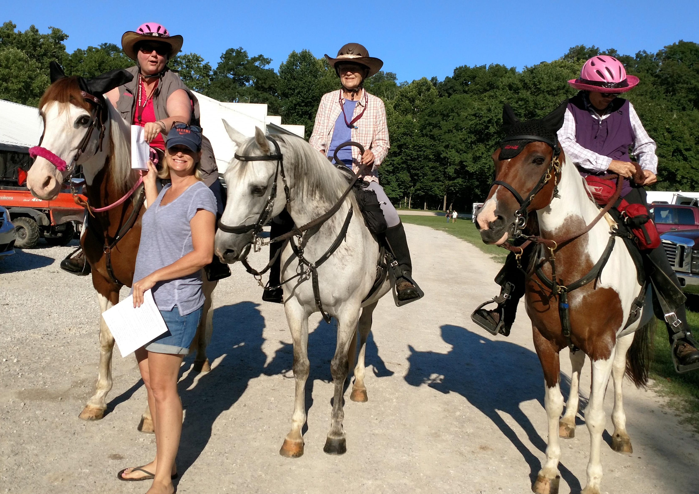
Notes:
Getting ready to go out – check out the cool hell hats!

Slide 15
Treasure Hunt on Horseback
5 Plates for the short course or 10 plates for a long course. Plates are also called markers, targets, Objective stations.
Short course is just one half of the long course – same plates, shorter distance.
1-? People per team
Riders and horses accumulate points
Ride managers also earn points
Points lead to annual and cumulative prizes.
Notes:
CMO has been described as a treasure hunt on horseback – both horses and riders earn points for markers found. If you find all the markers, you and your horse earn 10 points. From all those who found all the markers, the team or individual who has the shortest time, wins, and gets 6 additional points. Second place gets 5 points, etc. These points result in season and cumulative lifetime awards at both the state and national level.

Slide 16
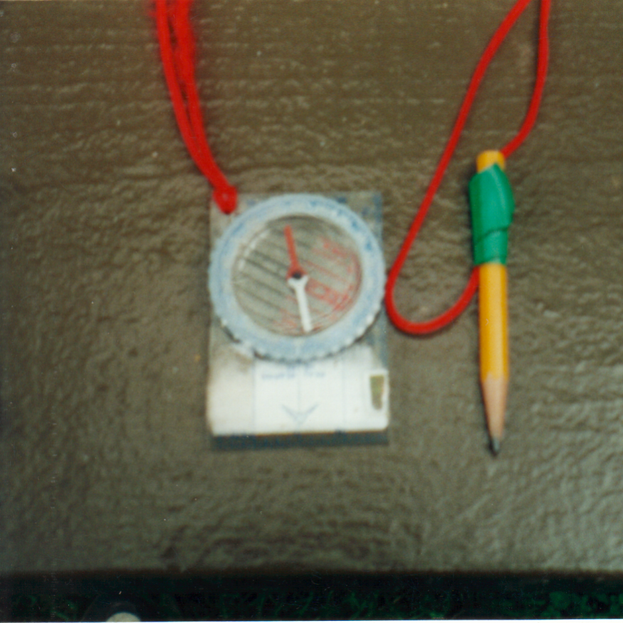
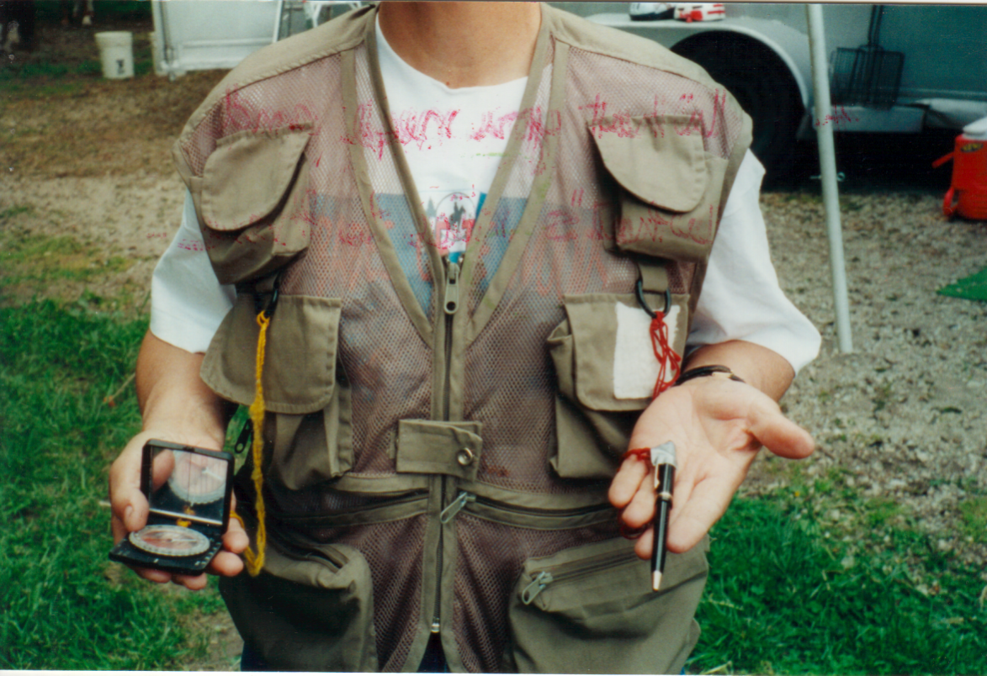
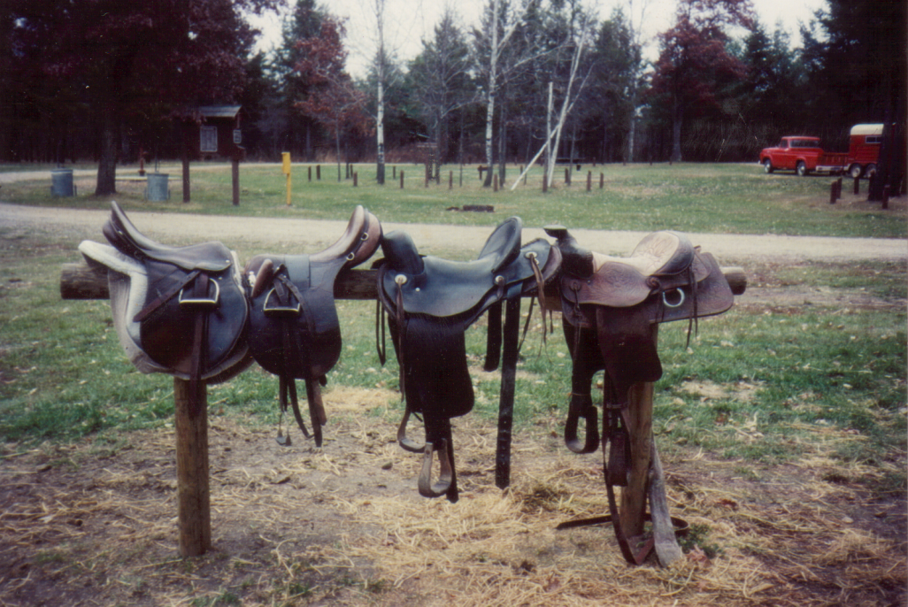
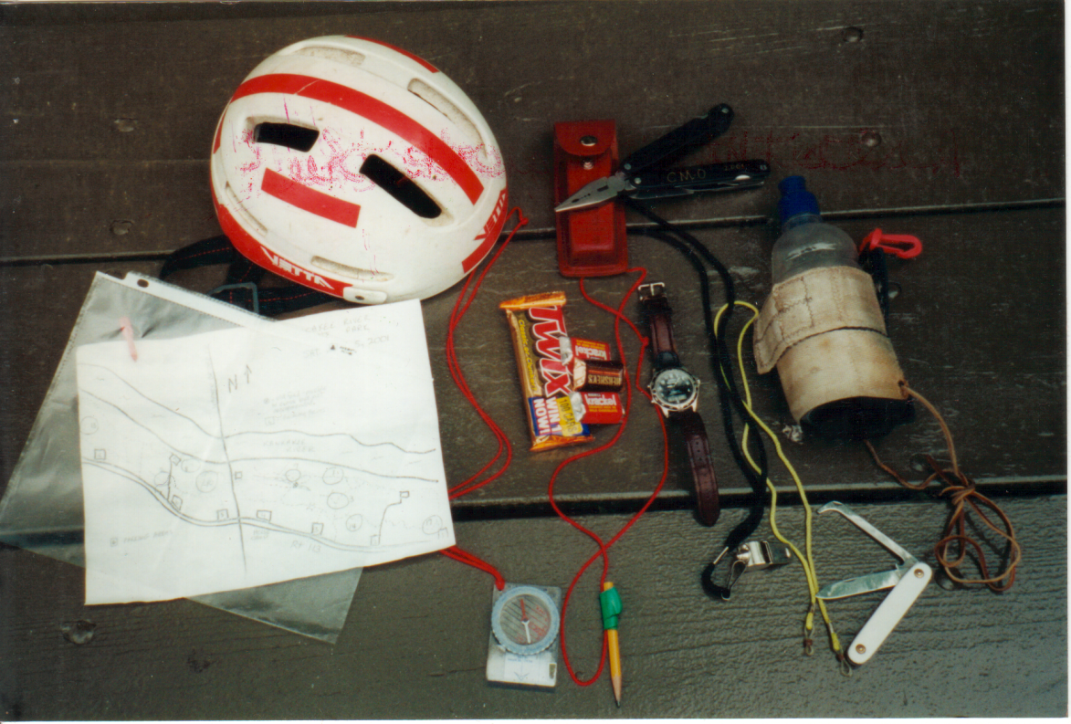
Notes:
OK, so what do you need to compete? The only real requirement is a compass – which basically is a device for determining which way is NORTH, and a pencil for writing down the letters that are on the plates when you find them.
“Orienteering” type compasses are readily available and feature a baseplate, a moveable dial and a double ended needle that floats freely - ideally in liquid. This makes it “settle” faster – a real bonus when your horse is moving around.
We have found a fisherman’s vest is handy to keep your compass and pen or pencil from getting lost and has pockets for snacks, water, first aid or emergency items.
Ride your horse in any gear that is comfortable for you both.
We strongly recommend helmets and cell phones be a standard part of your kit whenever riding.
You will receive your map when you start out and many of us like to have them in a plastic sleeve – helps keep them readable and in one piece.

Slide 17
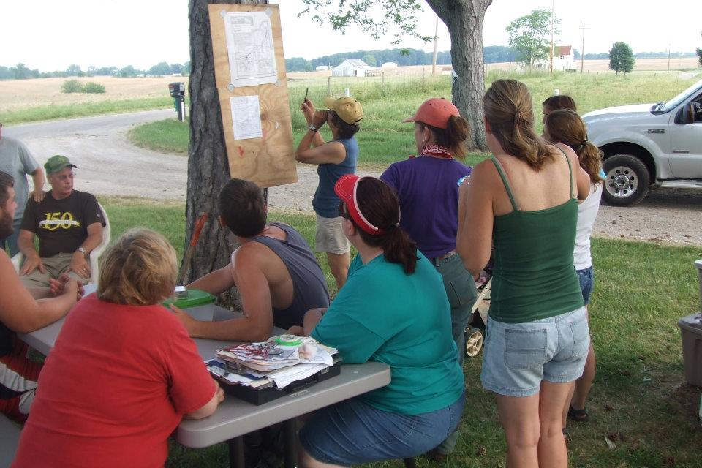
Notes:
At the pre-ride meeting the ride manager will show you a blank map of the trail system and tell you about any hazards or rules that apply to that area. There will be a marker set up in the campground area, that you can practice finding on foot.

Slide 18
Notes:
Time starts when the Ride manager hands out the maps. Teams are sent out at intervals of 10-15 minutes.

Slide 19
Notes:
Map of the area to be ridden is on one side – with the general location of the “markers” or plates shown by numbered circles.

Slide 20
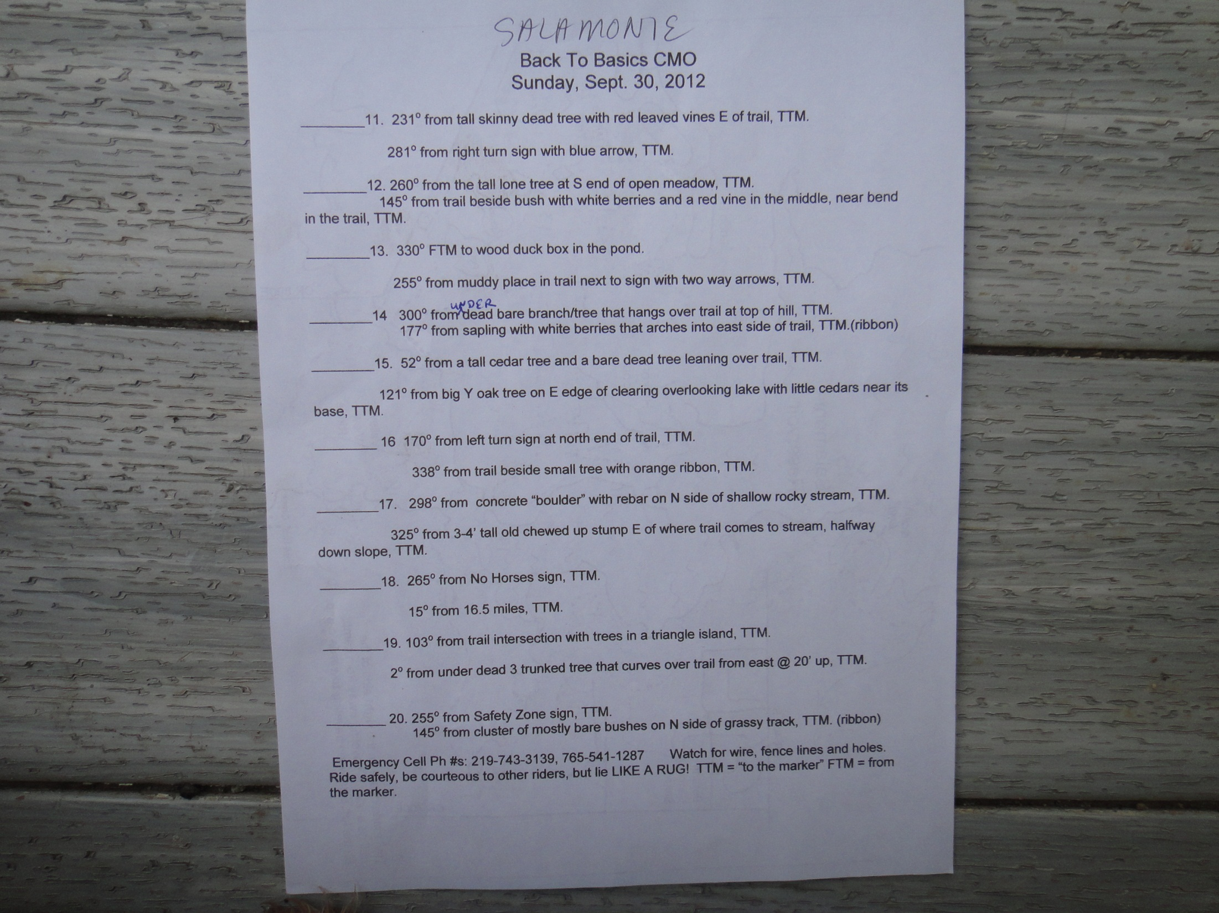
Notes:
On the other side are clues corresponding to the numbered circles that will help you find the plates.

Slide 21
Decide on your route
Notes:
Spend a few minutes looking at your map and deciding on your best route through the trails.

Slide 22
Notes:
When you have decided which marker to find first, off you go.

Slide 23
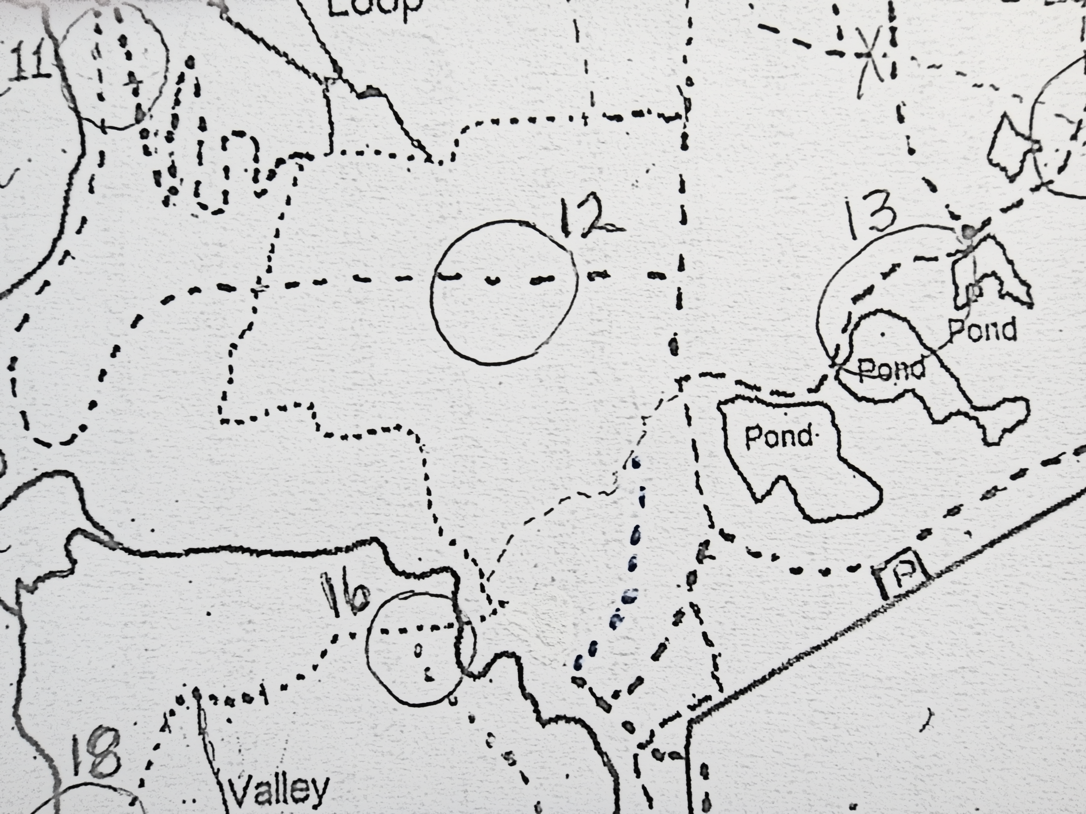
Notes:
Use your map and pay attention to natural features – creek crossings, ponds, trail intersections. to find the circled areas. Let’s look at #16.

Slide 24
Notes:
Lookfor the landmarks described for that number.

Slide 25
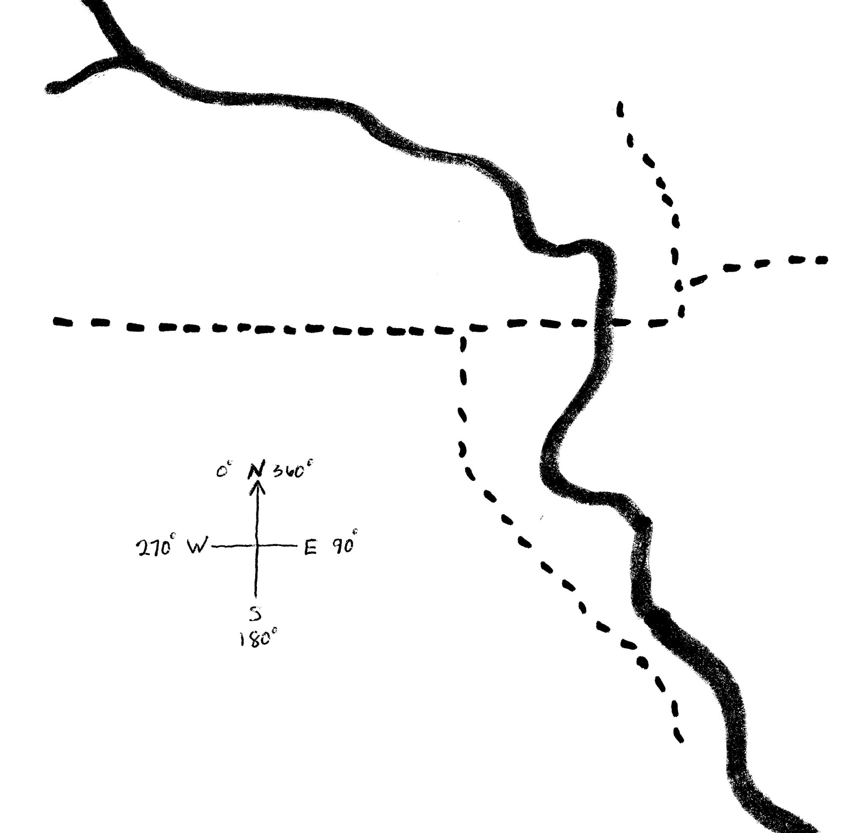
16
Notes:
The plate will always be somewhere within the circle. The landmarks may or may not be in the circle.

Slide 26
Notes:
Here’s one of the landmarks – The left turn arrow at the north end of the trail.

Slide 27
Notes:
Here’s the second landmark – the small tree with an orange ribbon.

Slide 28
170º from left turn sign at north end of trail, to the marker.
Notes:
170 degrees is almost straight south of the sign.

Slide 29
338º from trail beside small tree with orange ribbon, to the marker.
Notes:
338 degrees is northwest of the tree – between 270 (W) and 360 (N).

Slide 30
Notes:
The plate should be right here.

Slide 31
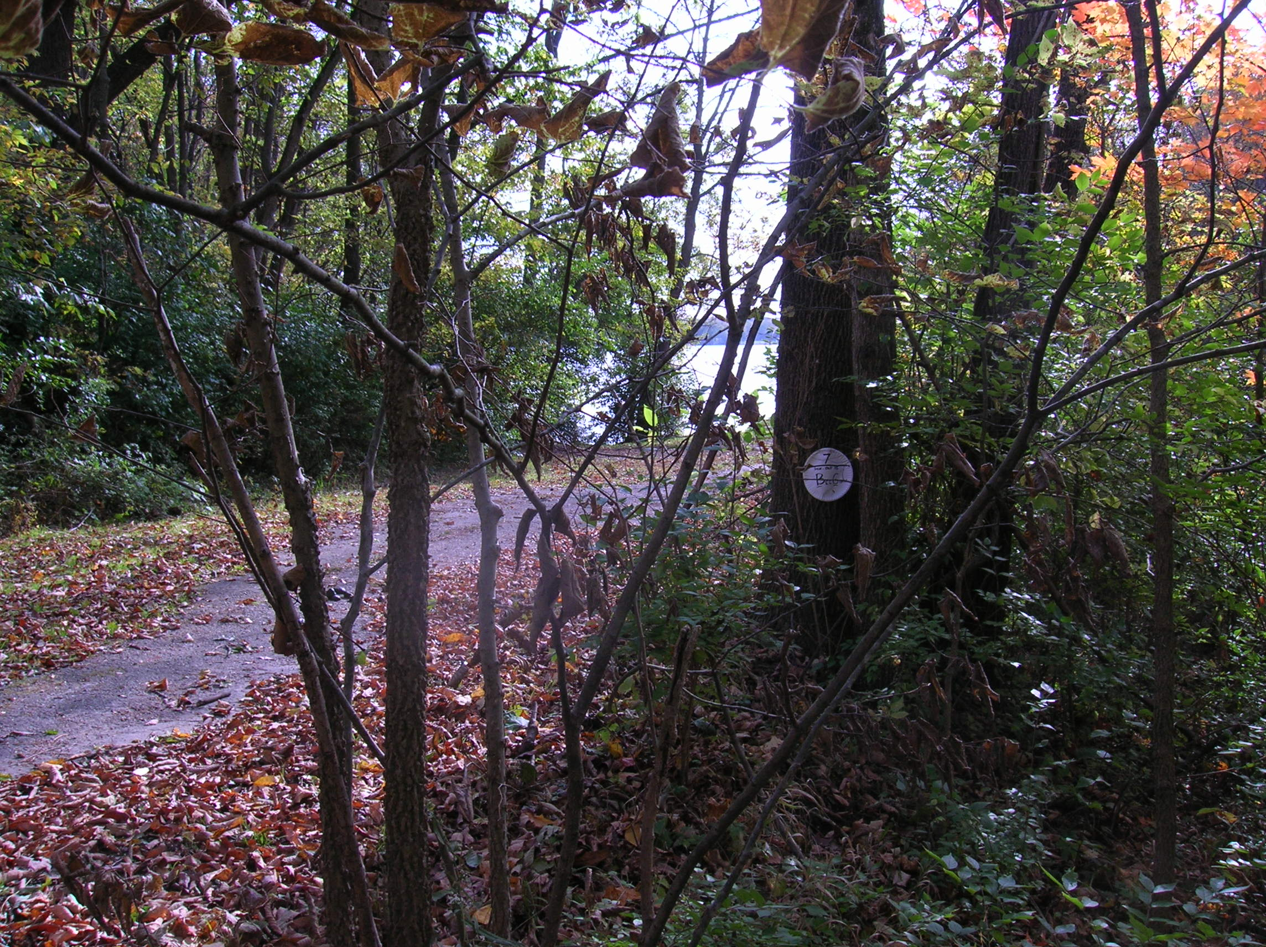
Hint: It’s right there!!
Notes:
Look around that area and find the plate!

Slide 32
Notes:
When you find the marker – write down the letters IS next to the #1 on your map – then head for the next one. Make sure to check the date!

Slide 33
Plates must be visible from horseback
Notes:
While it is legal to dismount at anytime, all plates must be visible and readable from horseback. Be aware that conditions may change and leaves, grass, etc. may make reading the plate difficult. Your horse must be agreeable to getting into a position so you can read it!

Slide 34
Notes:
When you have found them all, head back to camp.

Slide 35
Notes:
Hand in your map with all the letters written in, and you’re done. Only one member of a team needs to hand in a map.

Slide 36
Notes:
Your time stops when the LAST member of your team crosses the finish line.

Slide 37
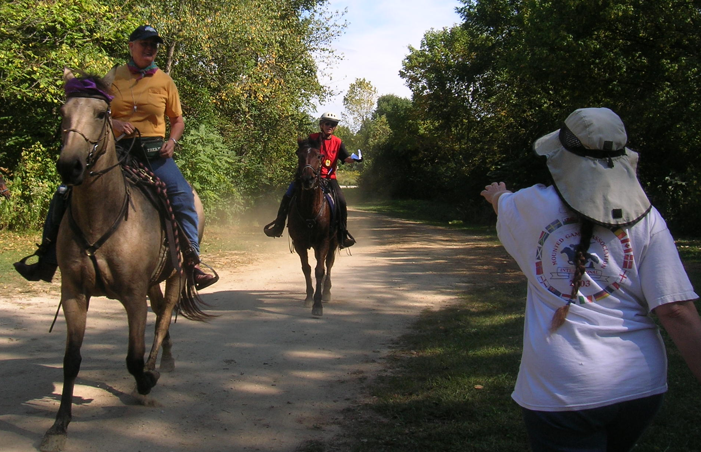
Notes:
The ride manager will time you in down to the minute and second. Some rides have come down to less than a minute!

Slide 38
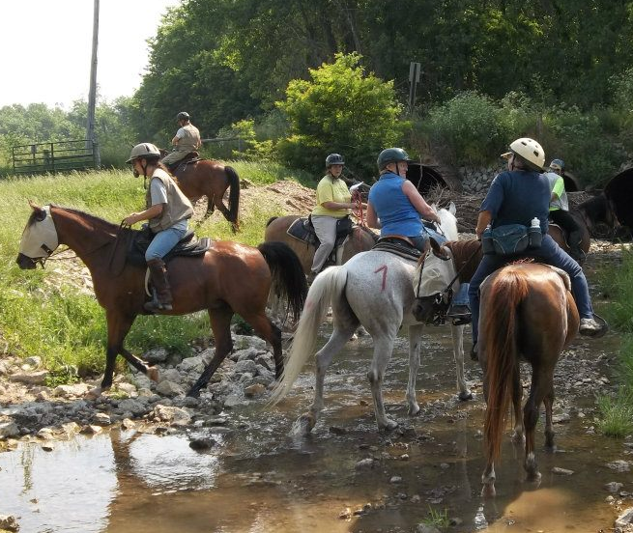
Notes:
Since you may find the markers in any order you like, it is very possible that you may encounter other competitors also looking for the same marker. Lie convincingly, develop a code to let your teammates know when you’ve found it, but you may not interfere with a marker or another rider. Notice the number on the grey horse – we number the horses to identify our riders as part of an organized event and to allow for identification of individuals.

Slide 39
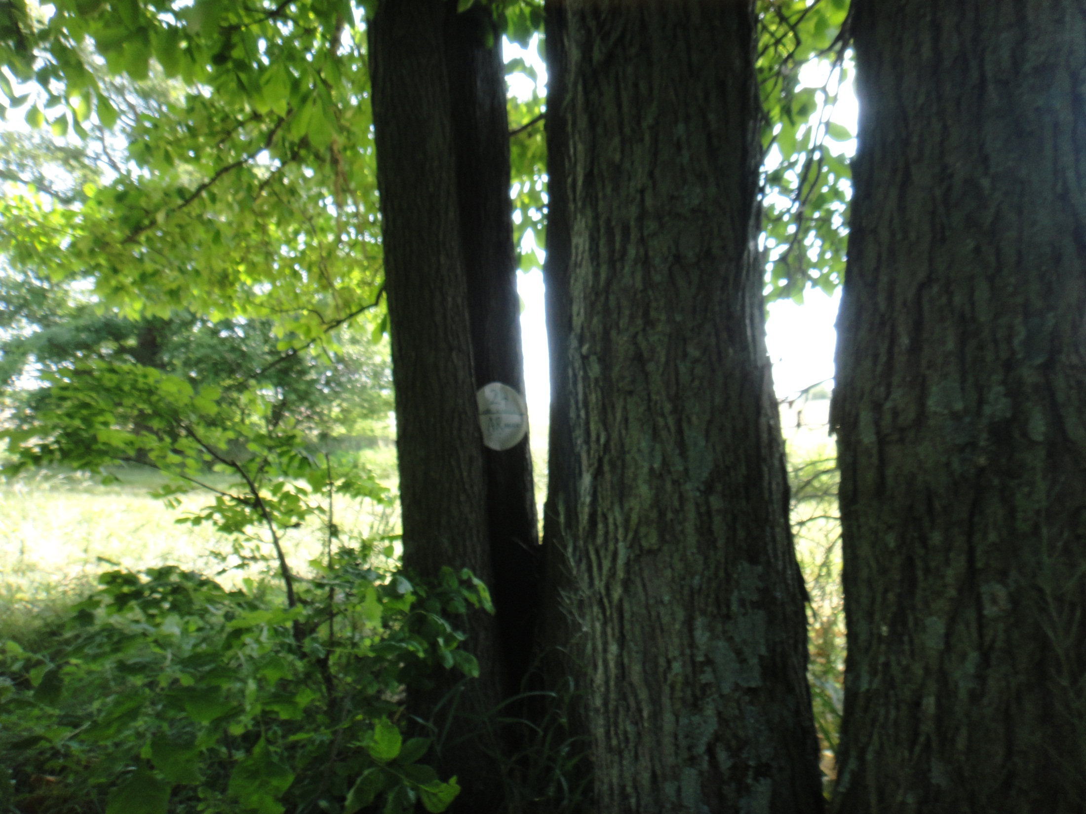
Notes:
What is obvious to one rider may be almost invisible to another. It’s fun to find out which skills the different members of a team bring to the game.
The plate can be high, low, behind or inside a bush or tree. Look all around! Since most of our parks require riders to stay on the trails our RMs have become very clever and sneaky.
Next
Next

Slide 40
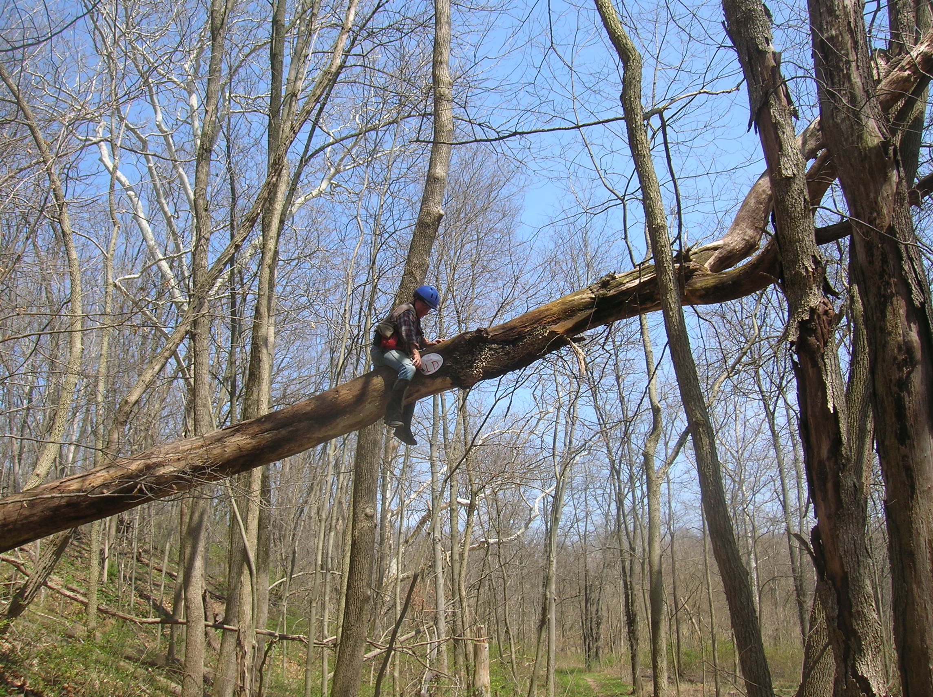

Slide 41
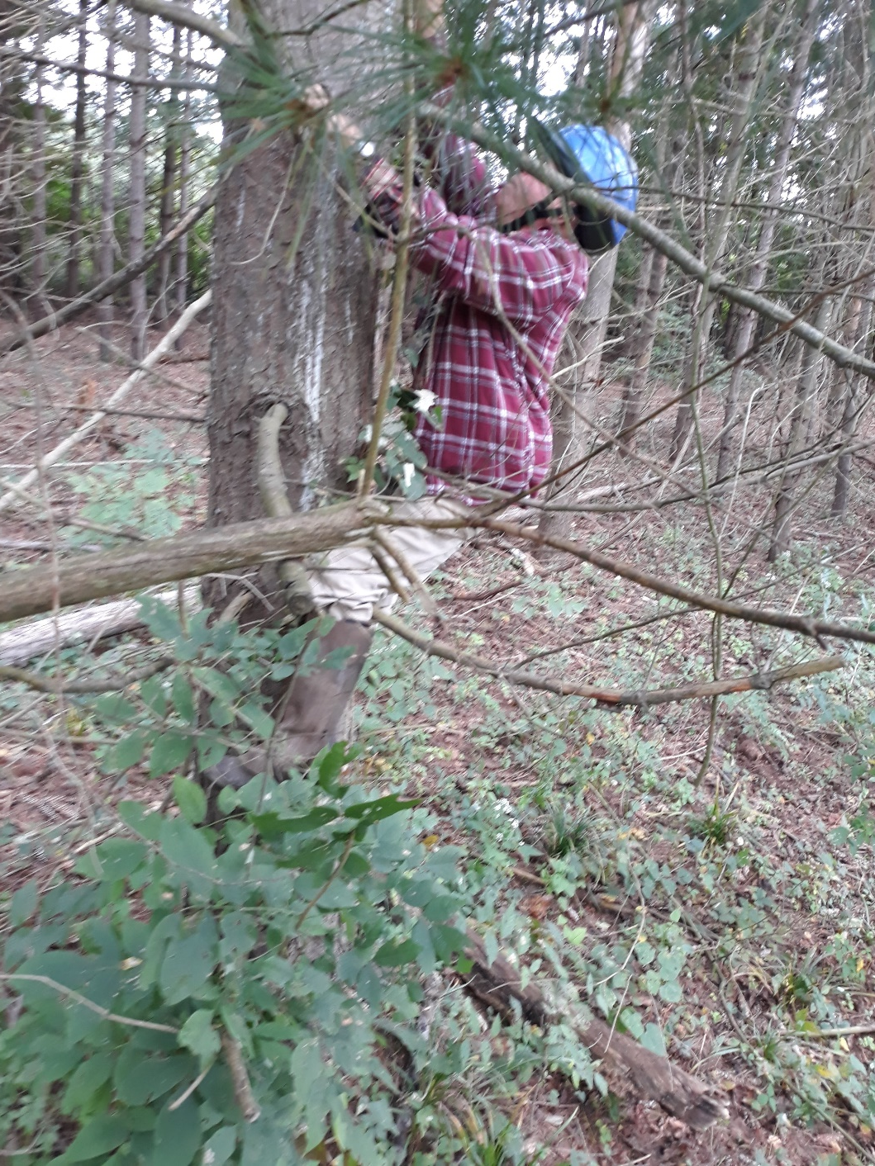

Slide 42
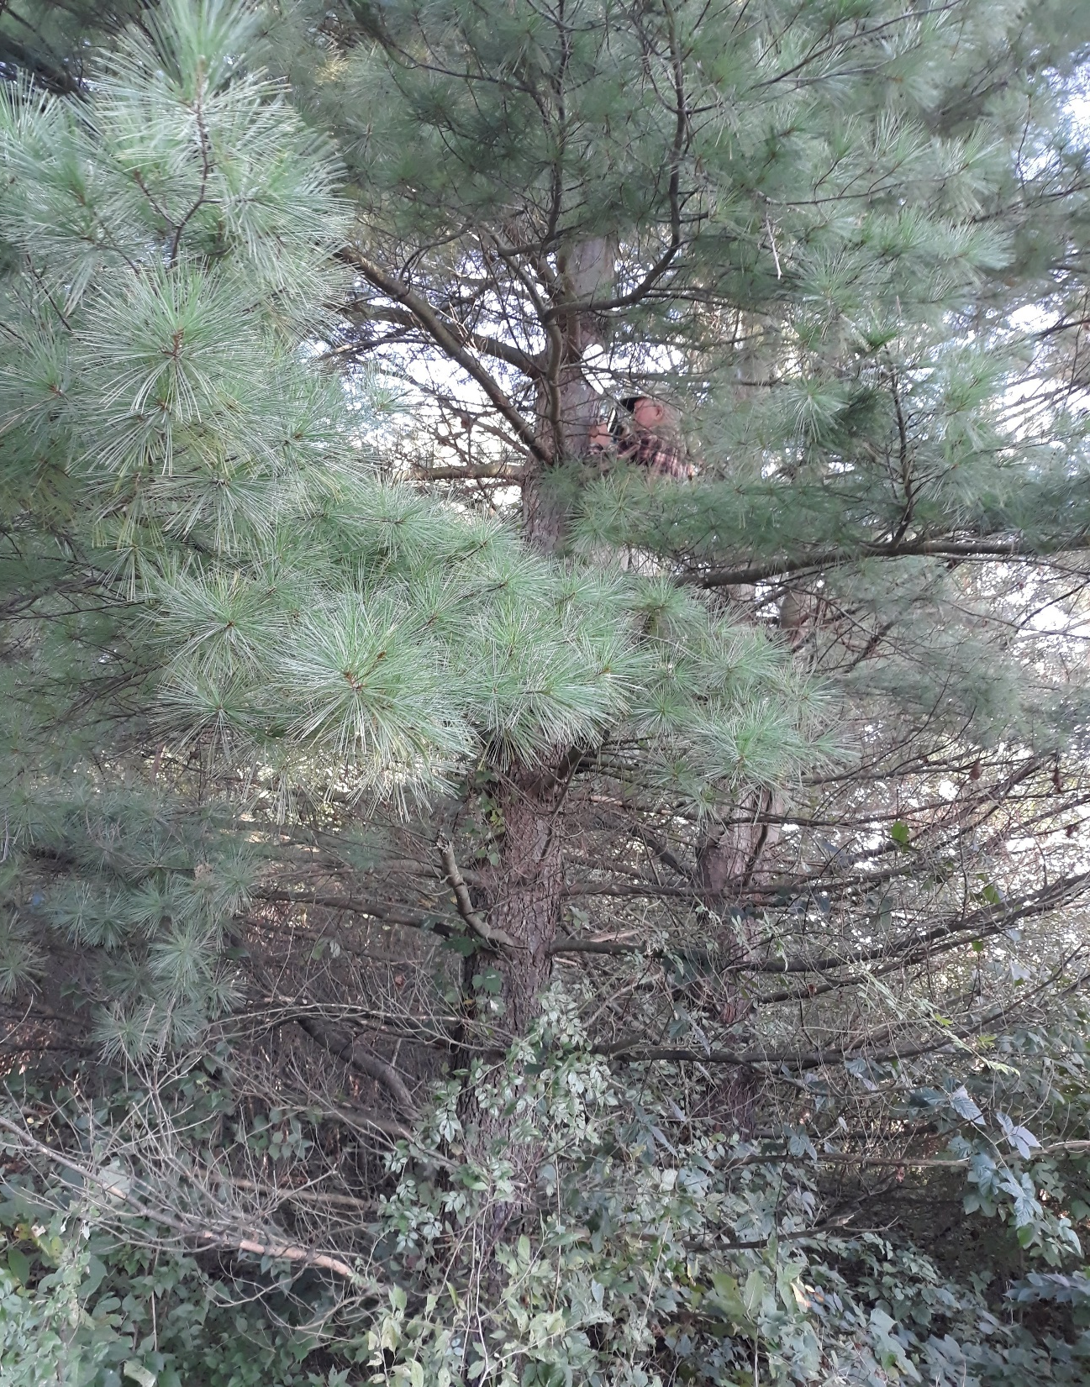

Slide 43
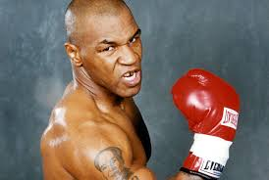
Unsportsmanlike behavior
Notes:
Rules
Sportsmanlike behavior: don’t be like Tanya Harding or Mike Tyson.
This is a low tech sport – no cops, no monitors. You are expected to behave with integrity. Leave all plates and landmarks as you find them. That means even if Mother Nature has tampered with them!

Slide 44
Flat walk only in camp
Notes:
Trail courtesy is paramouont. Horses are numbered, and riders are required to behave! When meeting other riders, we slow to a walk, ask permission to pass, pass safely, and do not move off in a rush.

Slide 45
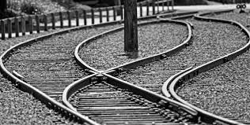
Split up then regroup
Notes:
If parts of more than one trail are in the circle, it is fine for your team to split up and travel both trails to find the landmarks. You must get back together before heading off to the next marker.

Slide 46
Notes:
Let’s look at # 14. It is ok for part of your team to ride up the eastern trail to the north and the others to ride up the western leg to locate the landmarks and the plate. You must regroup and ride to the next circle together.

Slide 47
Notes:
Here’s an example of what you may not do – you can’t split up to find both 28 and 29 at the same time. You must all ride together from one to the other.

Slide 48
Equines must be at least 3 years old to compete

Slide 49
All riders welcome!
Annual members or day members
For insurance purposes
Notes:
Annual members pay for an annual NACMO membership and usually a chapter membership. These fees help fund our year end prizes and pay for our insurance costs. Our insurance requires all riders to be members, so non annual members may buy a one day “membership” for $5. Annual memberships are $40 for a family or $25 for an individual. Our chapter dues are $10. Entry fee for each ride is $12 ($17 for day members).

Slide 50
Costs
Annual membership – family - $40
Annual membership – Individual - $25
Chapter dues - $10
One day membership - $5
Entry fees Adults– $12 per rider per day
Junior riders - $6 per junior per day

Slide 51
What about the points?
Points are for markers and time.
One point per marker
Of the teams that find all the plates, the fastest team gets 6 points, next 5, etc.
Horses get marker points only
EX – find all the plates in the fastest time – you get 16 points, your horse gets 10.
Short course is just half. Winning team gets 5 marker points and 3 time points.

Slide 52
Talk to each other – don’t call!
No electronic devices!
No GPS! Cell phones for emergencies only!
Notes:
The use of electronic devices is prohibited. Cell phones must be stowed during the ride and taken out for emergency purposes only!

Slide 53
AWARDS
Notes:
When the ride is over and all the riders are in – it’s time for awards. Since this is a low tech, low cost sport, the prizes are not monumental – usually horse related items like this bucket or camping equipment etc.
T shirts are good for bragging rights.
Handmade items are fun too. Bridle holders.

Slide 55
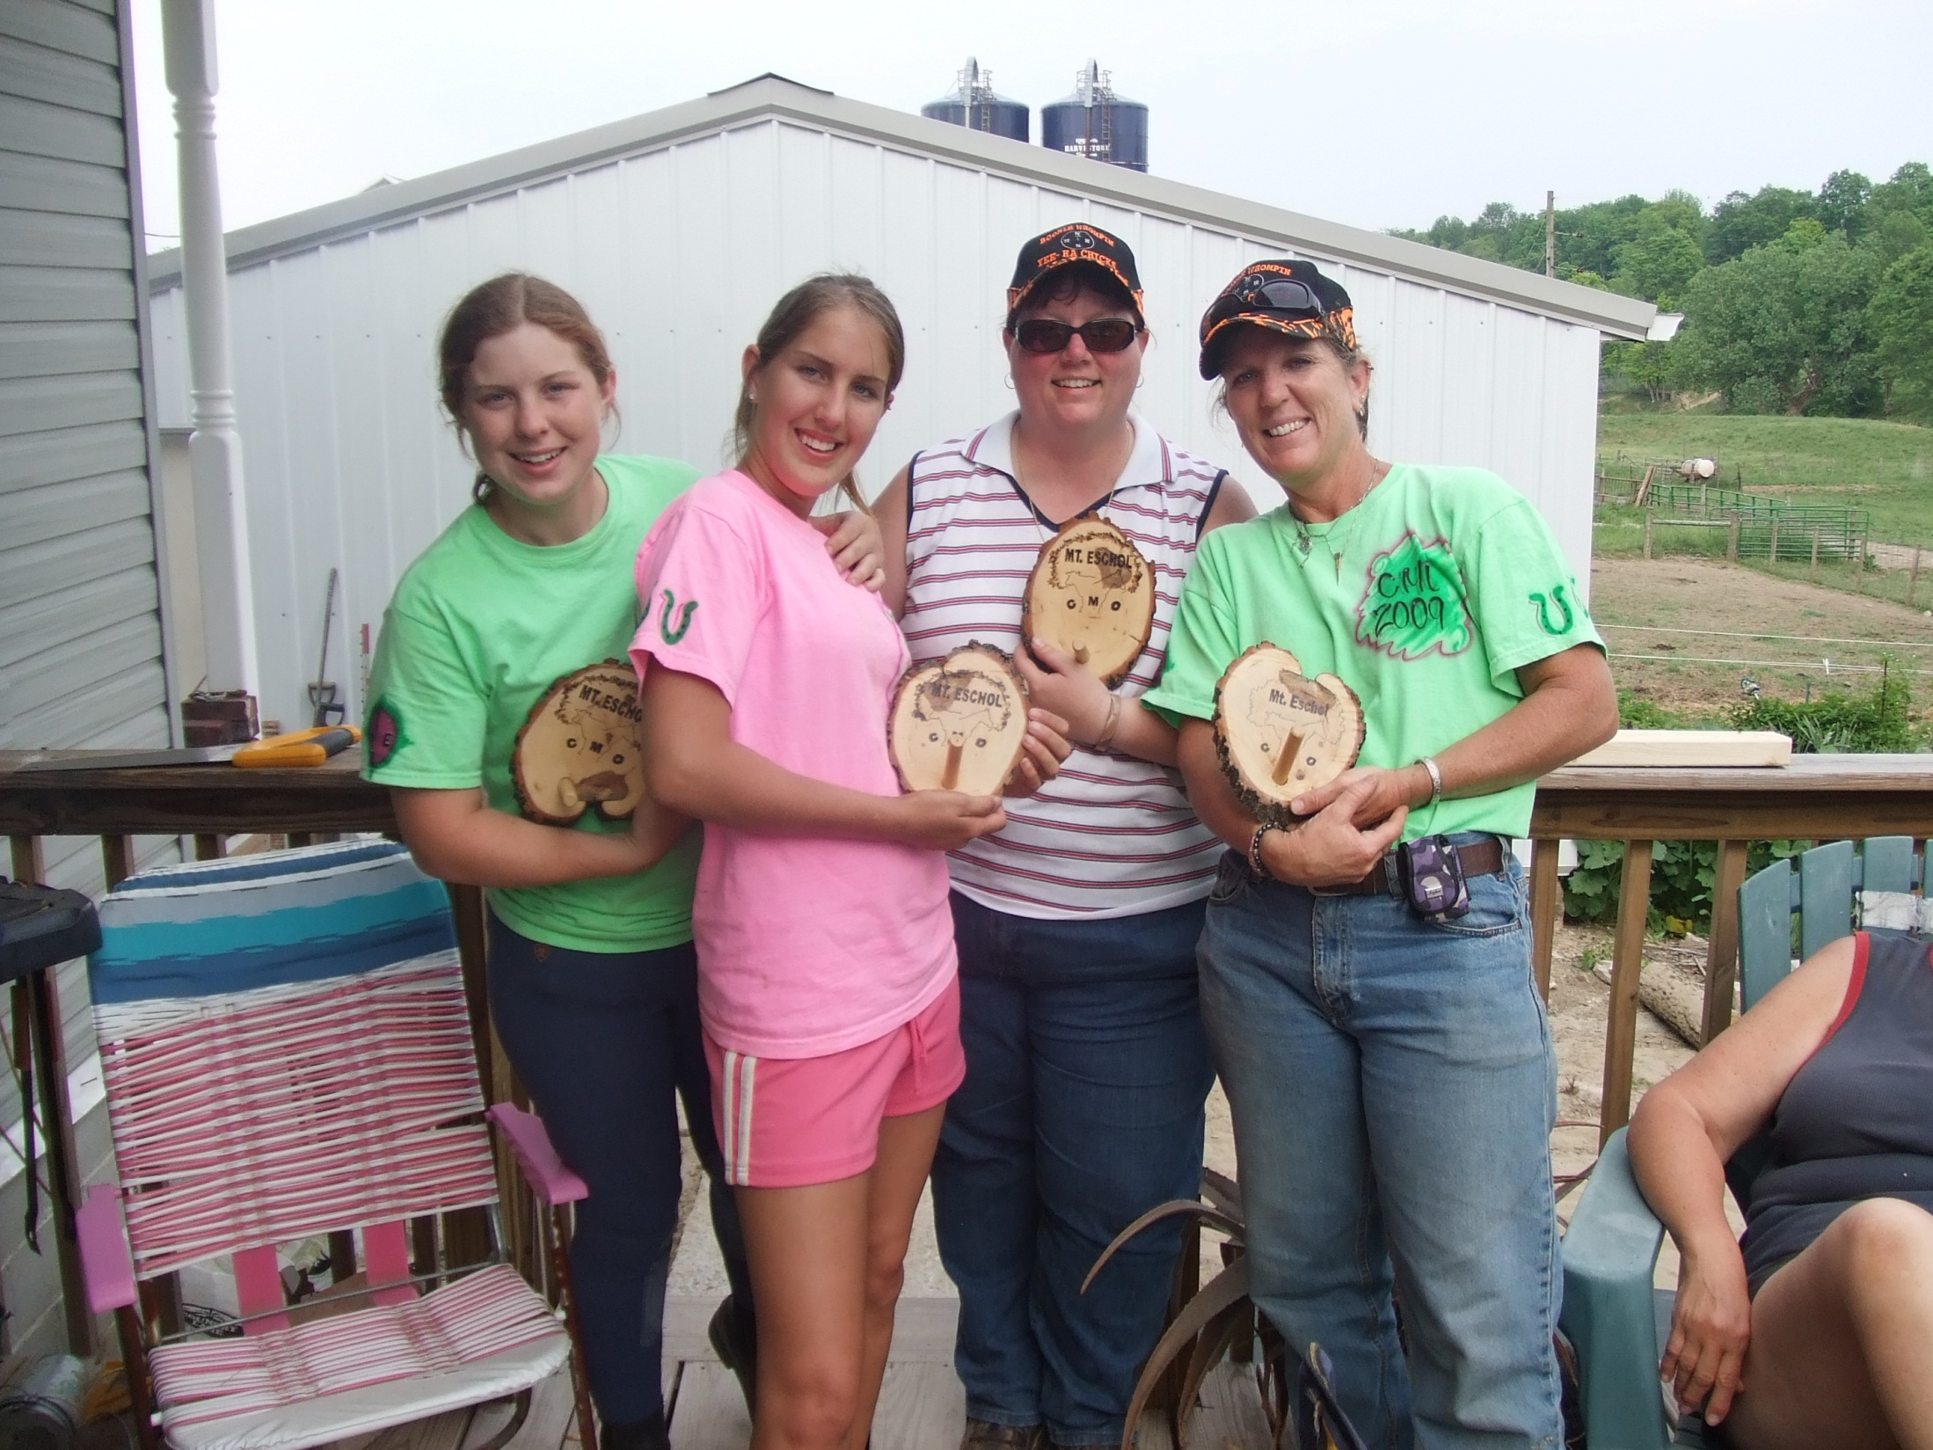

Slide 56
Notes:
CMO riders often get to places not often seen by regular trail riders.

Slide 57
Notes:
And we know how to relax after a long day on the trails!

Slide 58
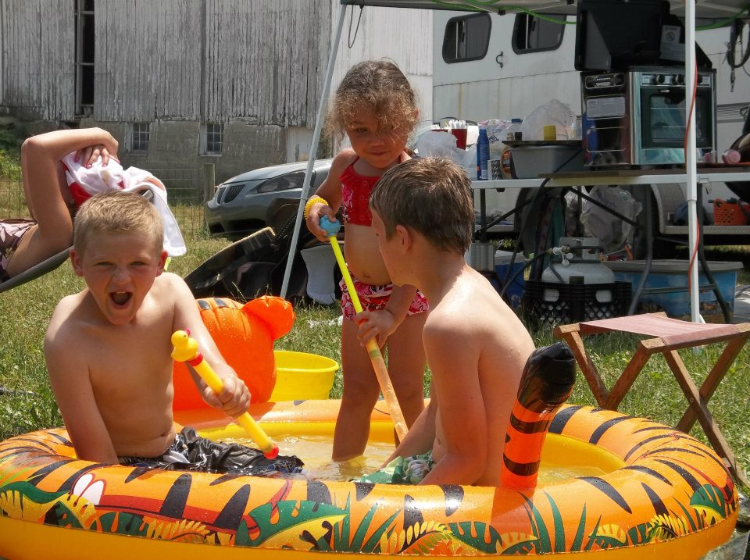
Notes:
Relaxation can take many forms!

Slide 59
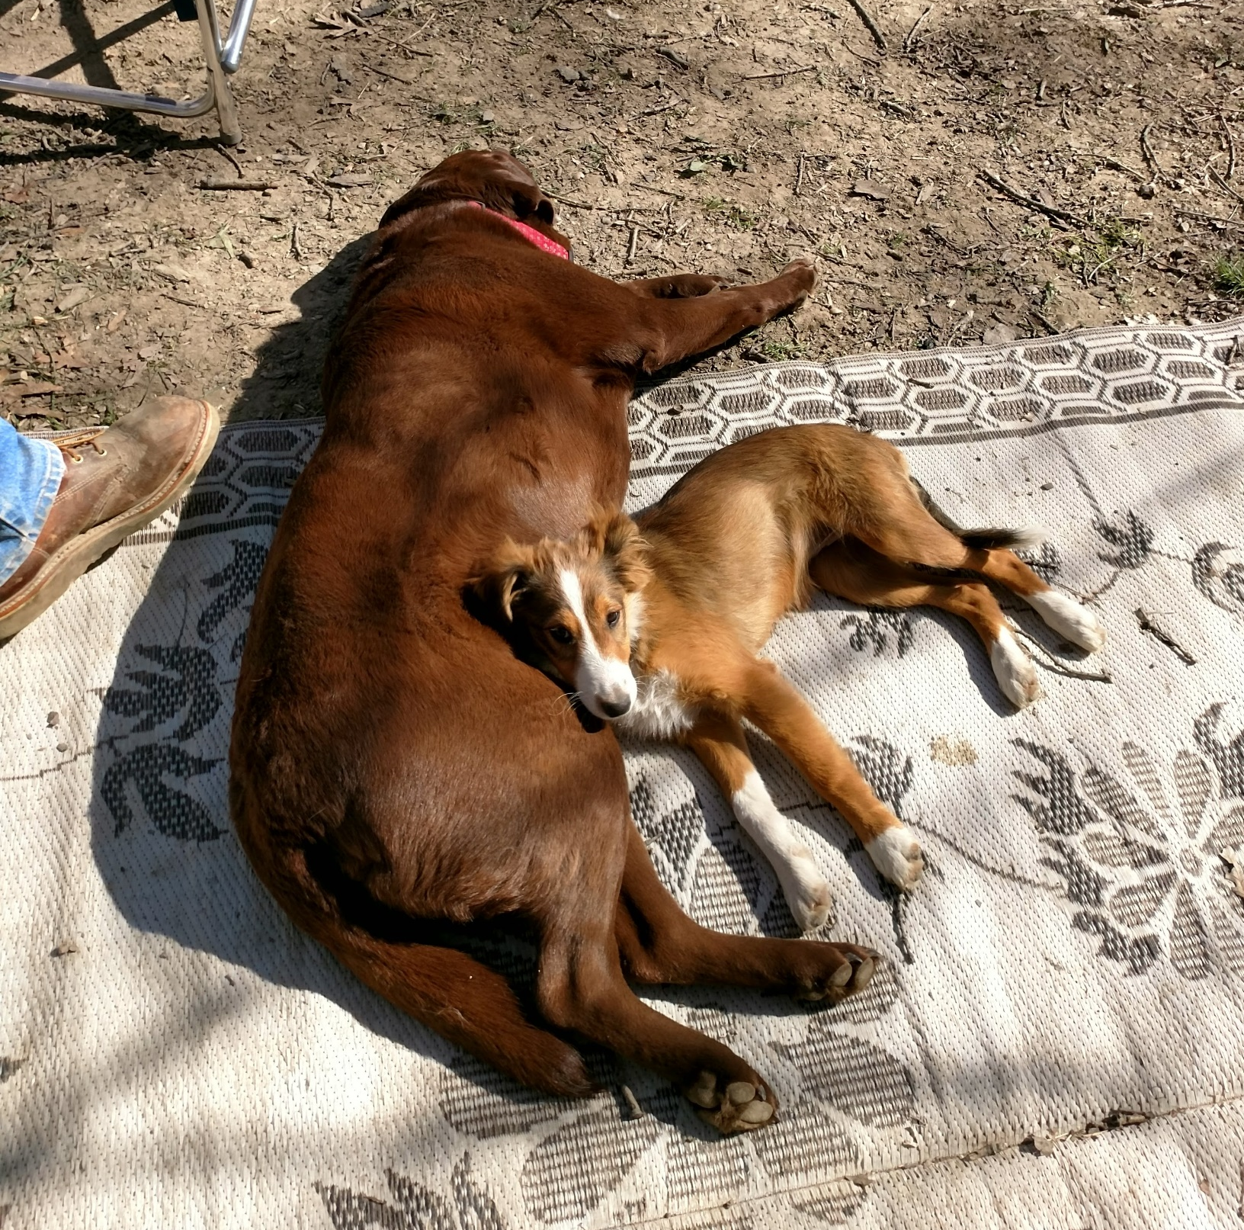

Slide 60
Notes:
For many of us, the best part of the sport is the time spent around the campfire.
With good friends.
Some campfires are warmer and dryer than others!

Slide 61
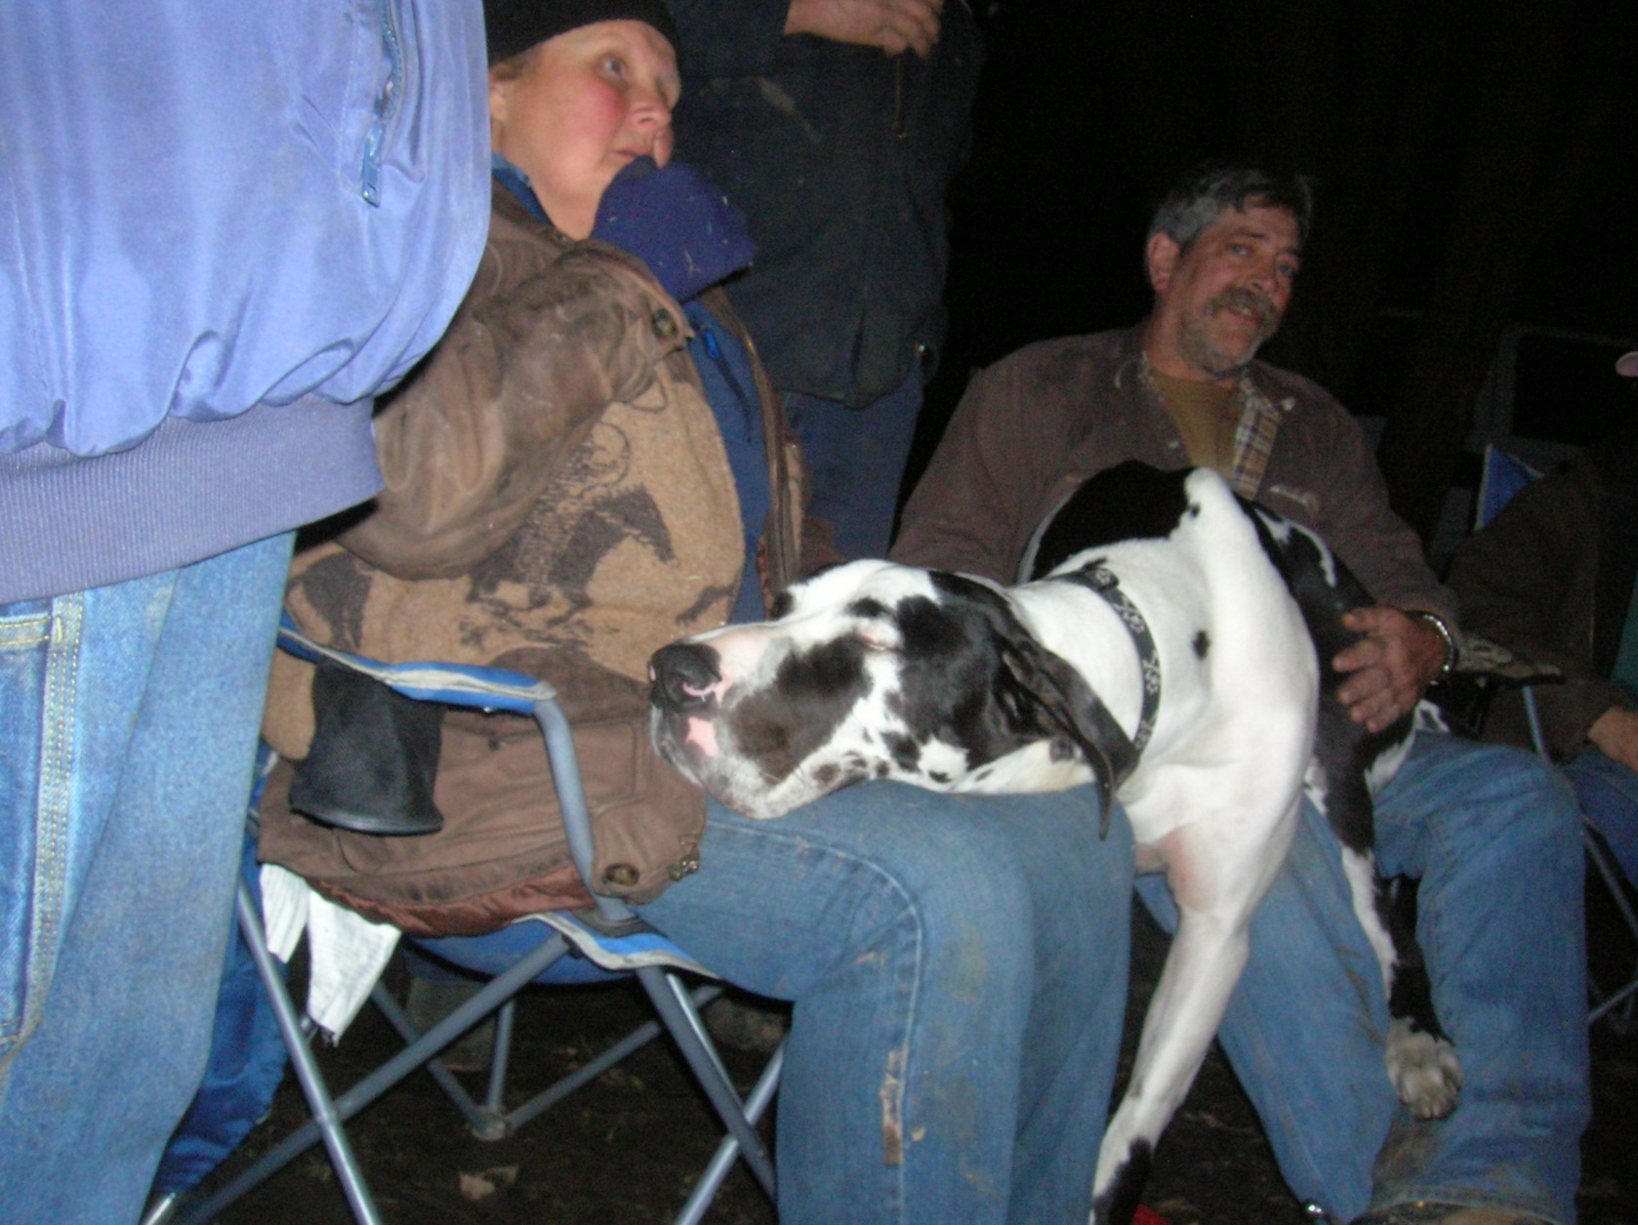

Slide 62
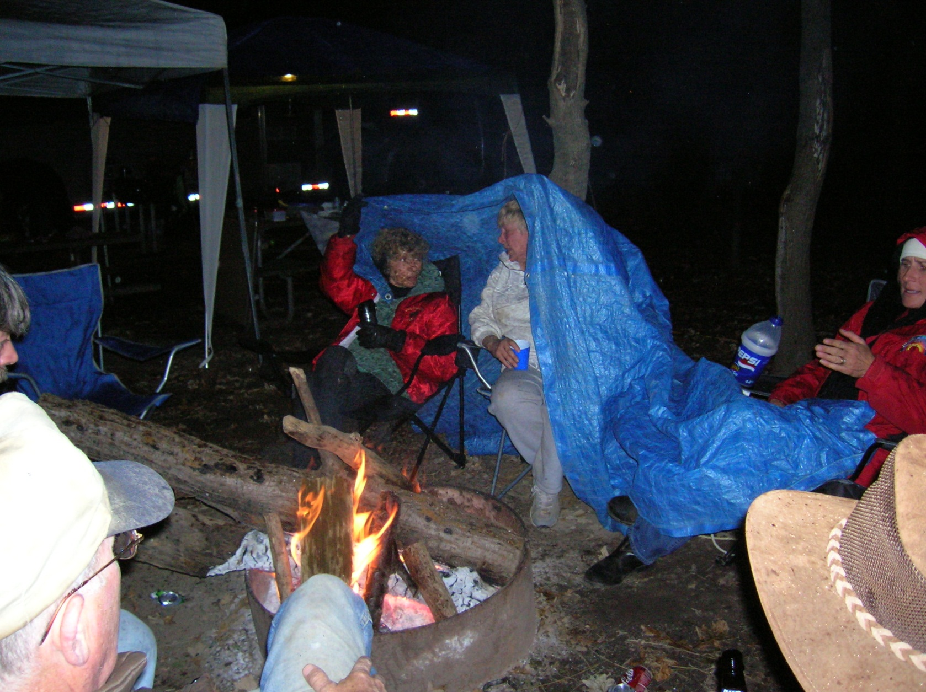

Slide 63
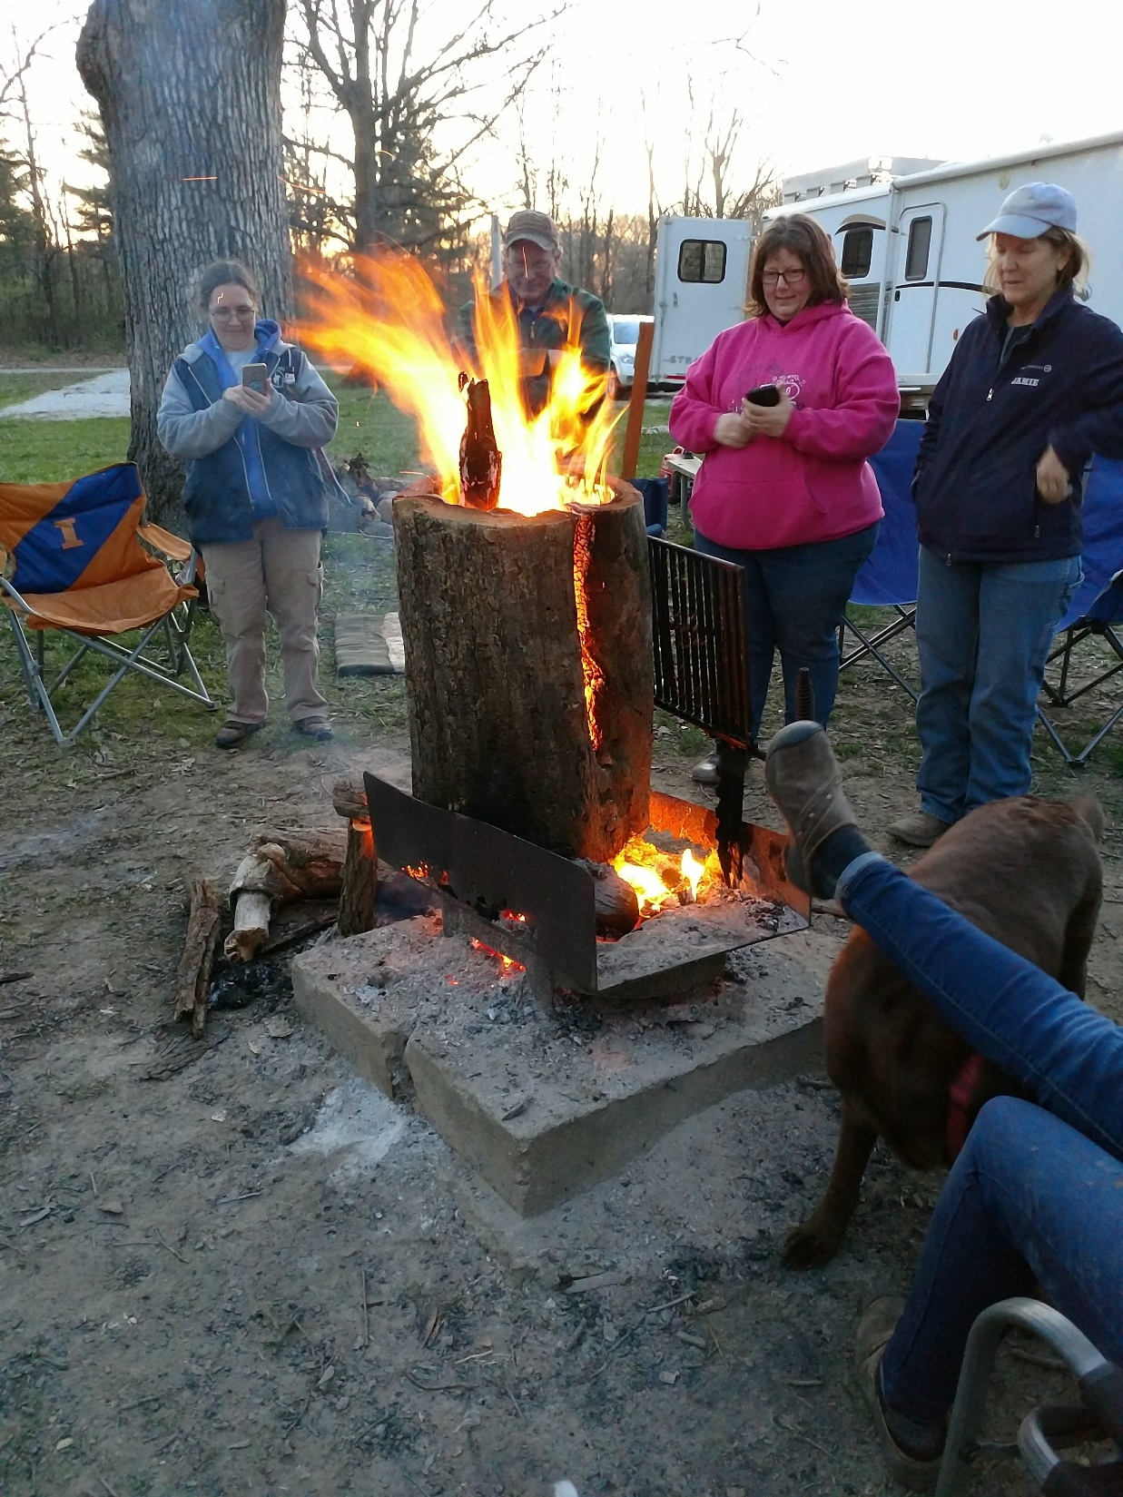

Slide 64
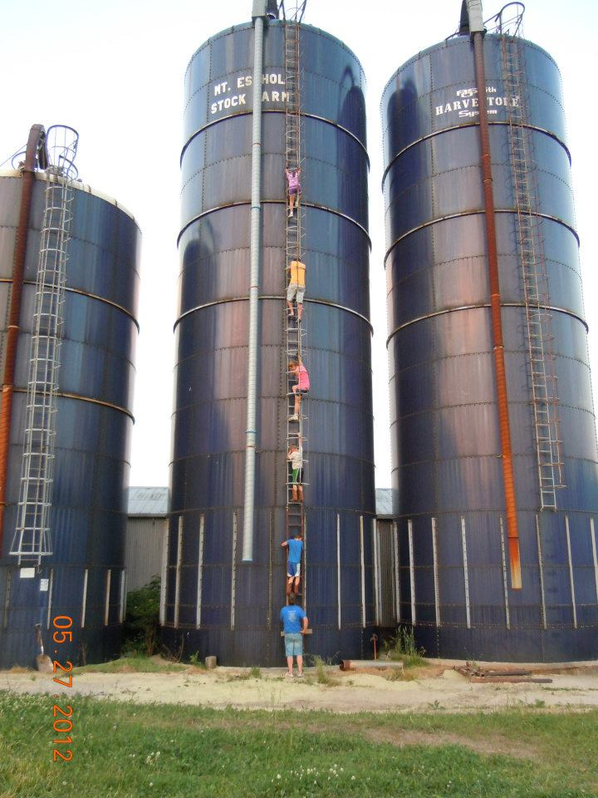
Notes:
At some CMO’s there are additional activities available

Slide 65
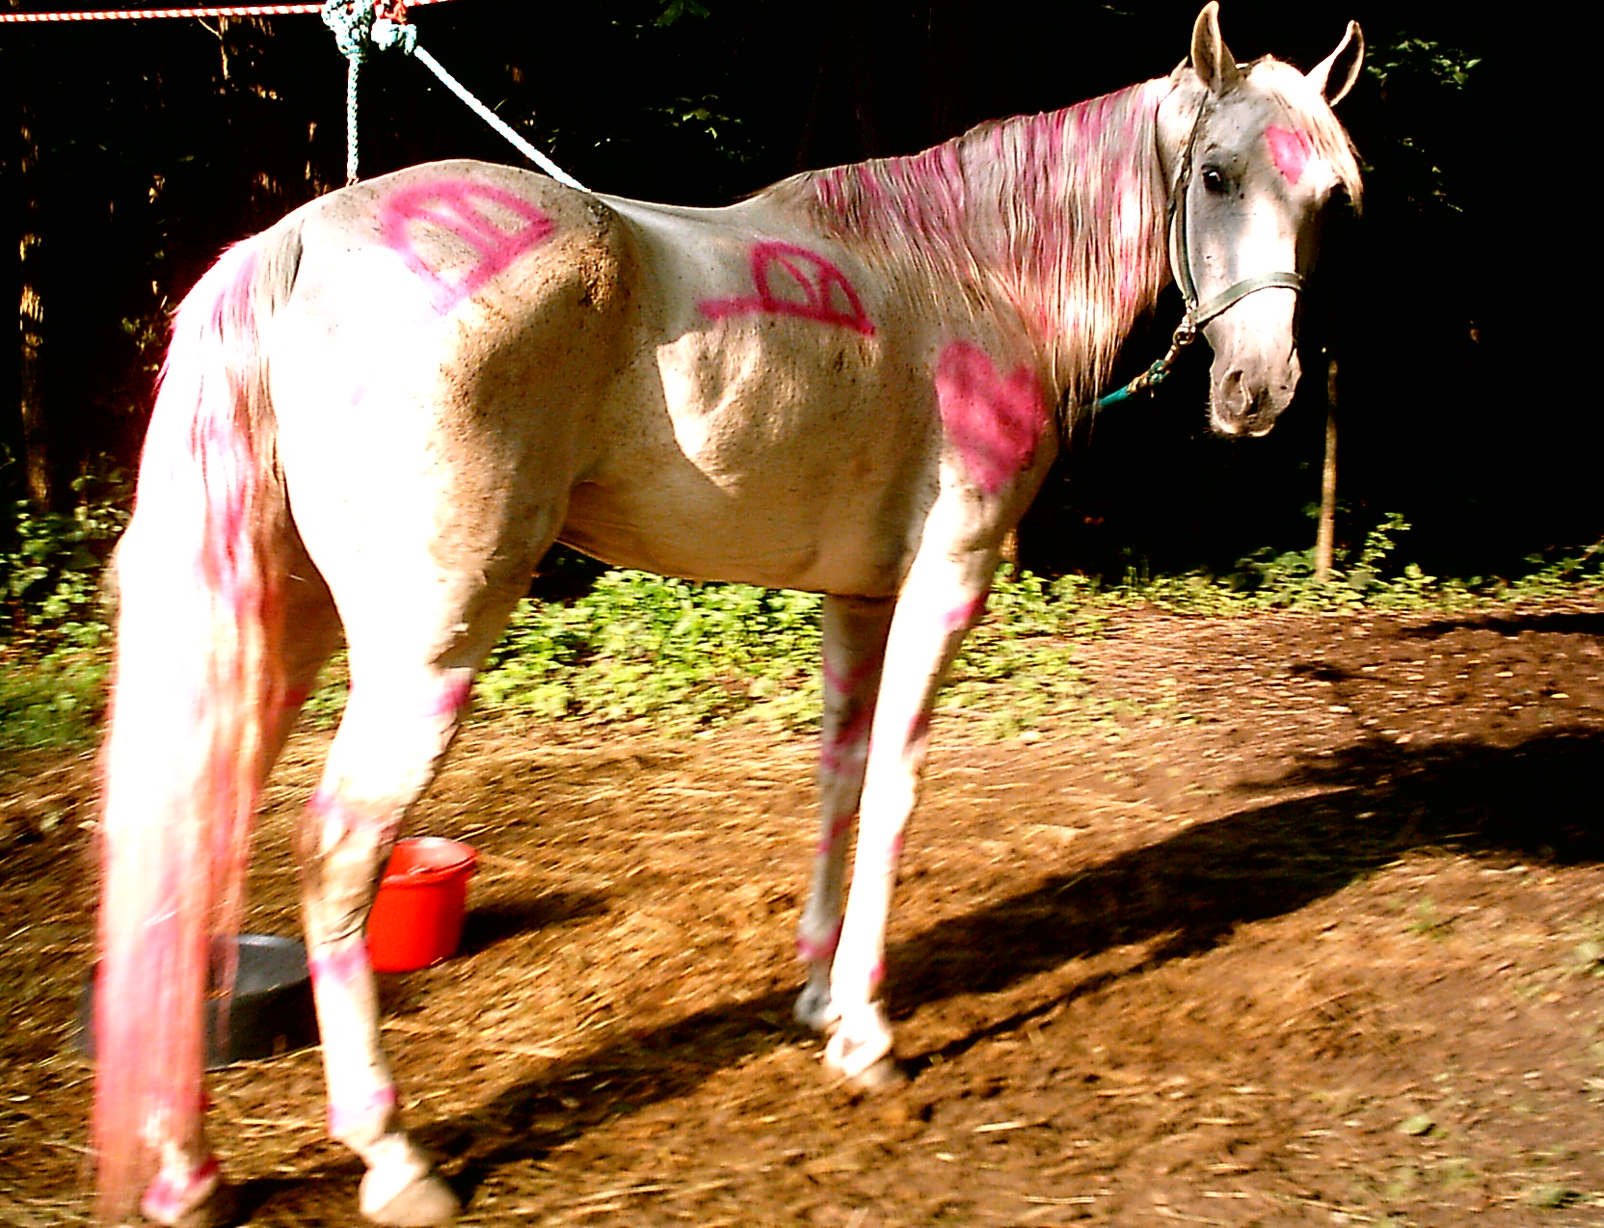
Notes:
But one thing is standard – there is always room for silliness.

Slide 66
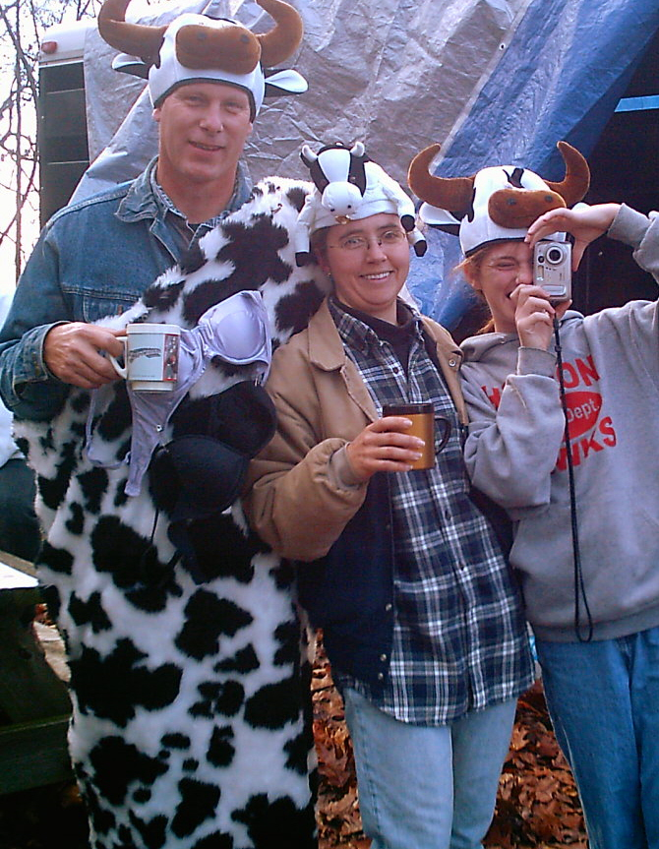
Notes:
Silliness in another form at a Halloween ride.

Slide 67
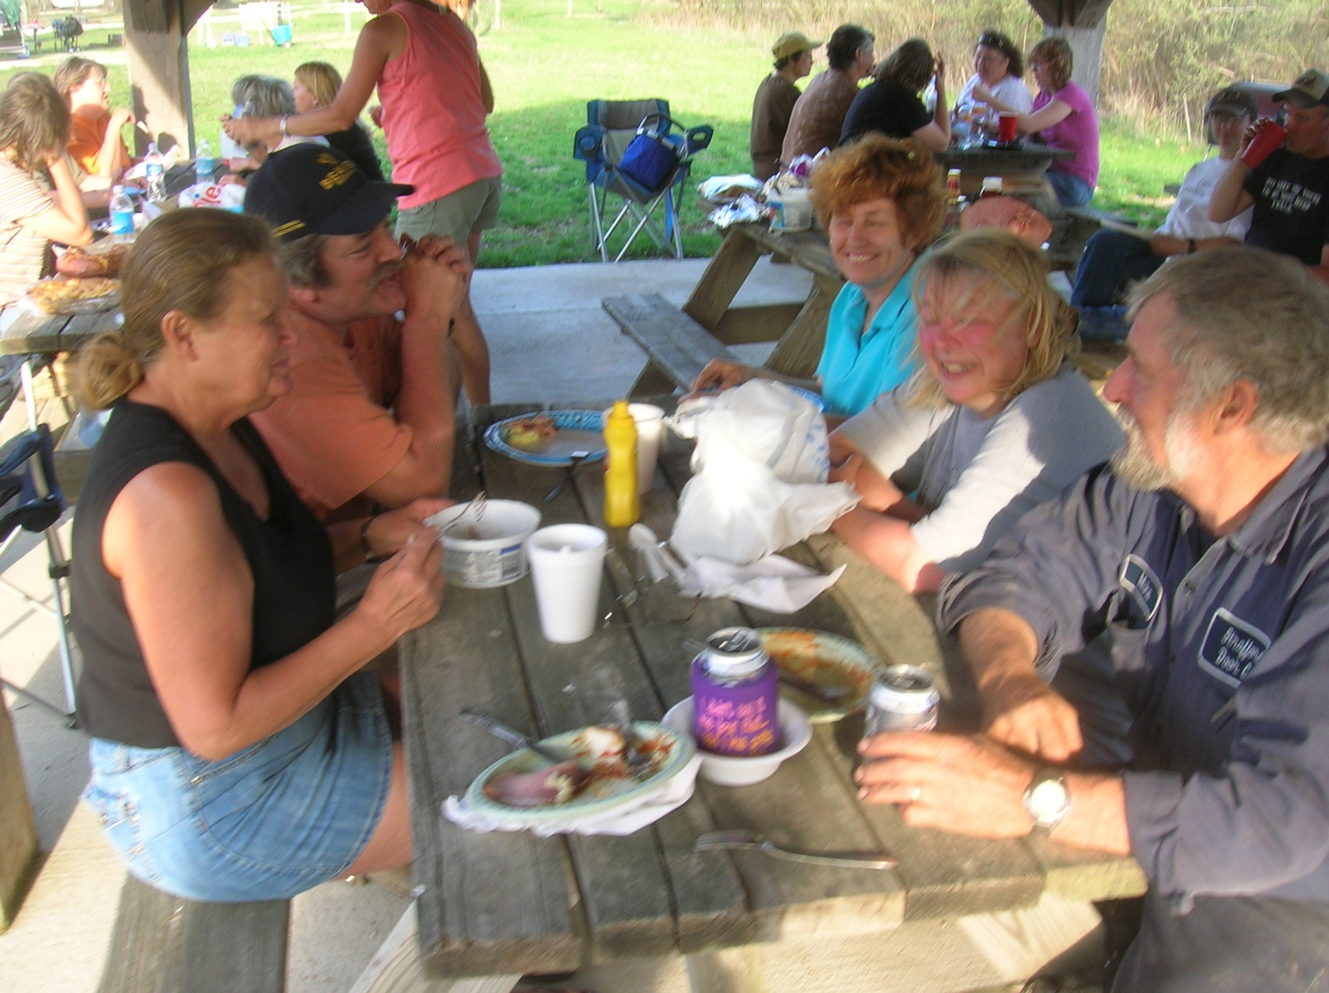
Notes:
Always featured are our famous potluck suppers – held the evening of the Saturday ride.
Most of our rides take place over a weekend and we plan a pitch in dinner on Saturday evenings. Everyone brings a dish to share and we rehash the day’s events, who lied to who, who got lost, who’s horse was AWESOME!
We never run out of wonderful food!

Slide 68
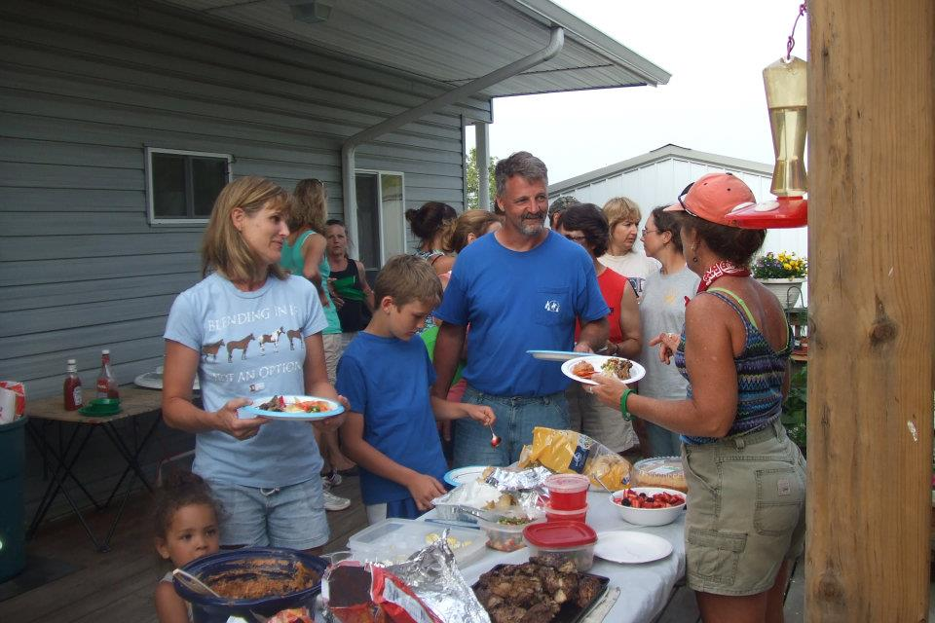

Slide 69
Notes:
We never have an insufficiency of wonderful food.

Slide 70
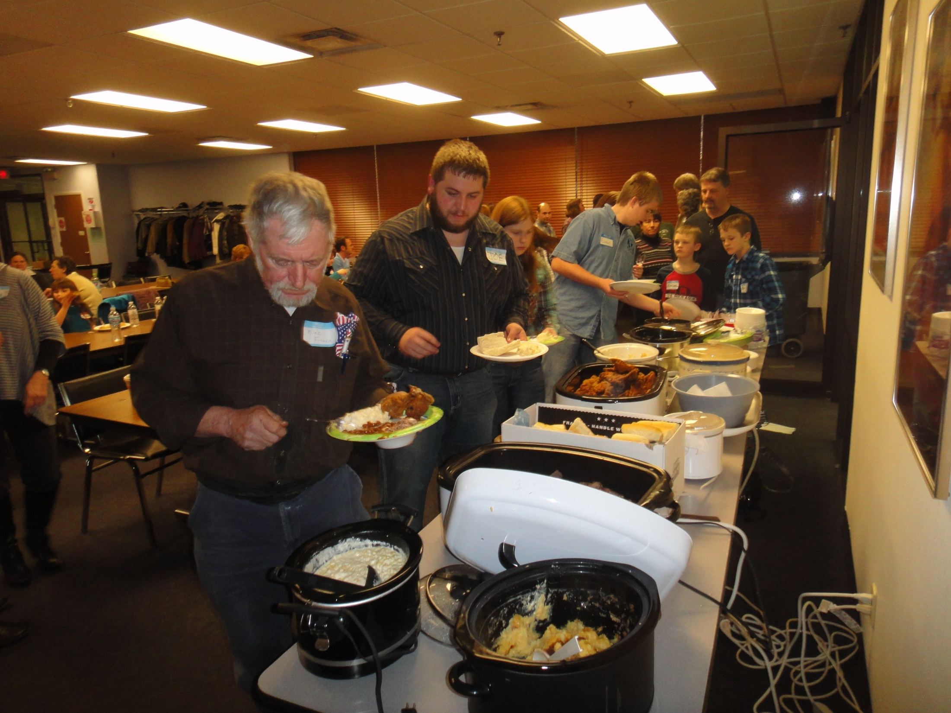
Notes:
Our annual awards banquet, typically held in February, is no exception – a grand feast followed by silly and serious awards for season – long and cumulative lifetime accomplishments.

Slide 71
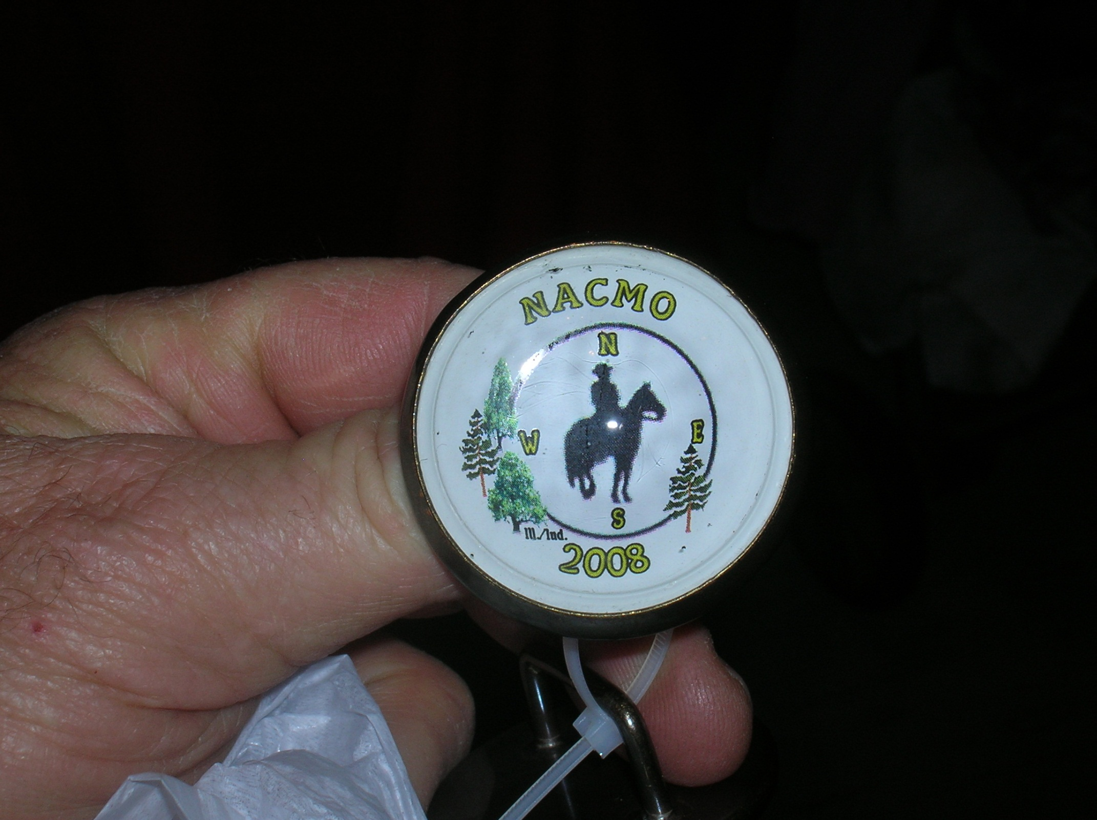
Notes:
Awards can be bridle tags,
Cumulative horse awards. A personalized halter for 600 points and a stable sheet for 800.
When you reach 1000 points, you get a chair to rest your weary bones!

Slide 72
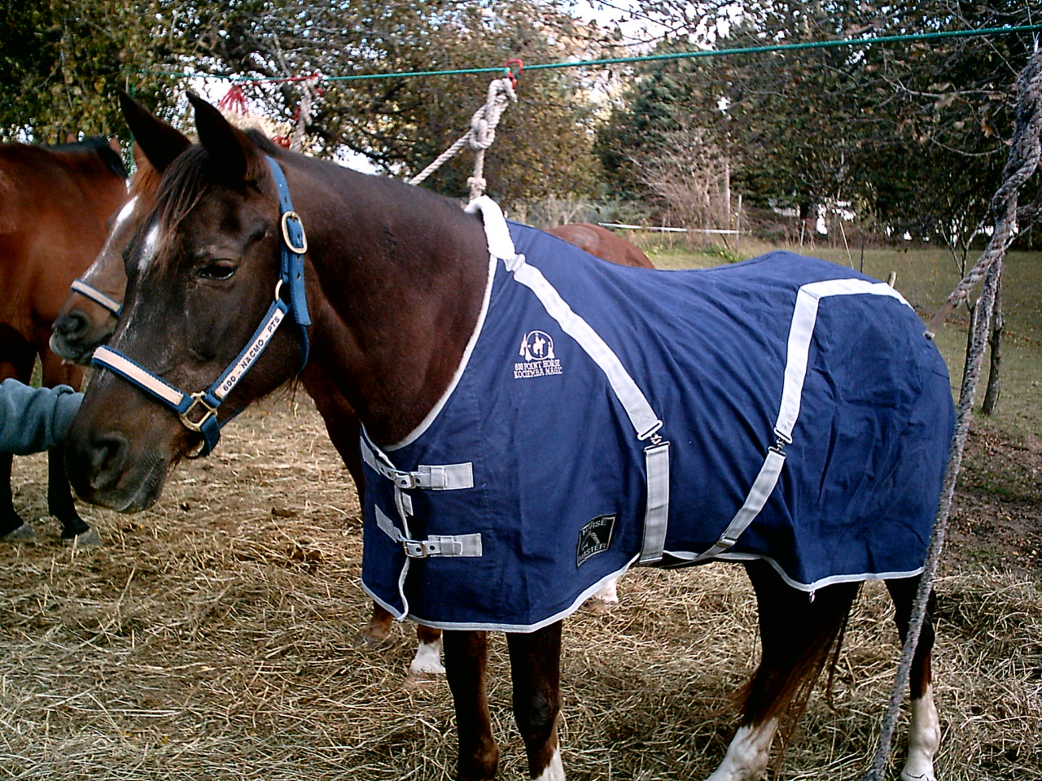

Slide 73
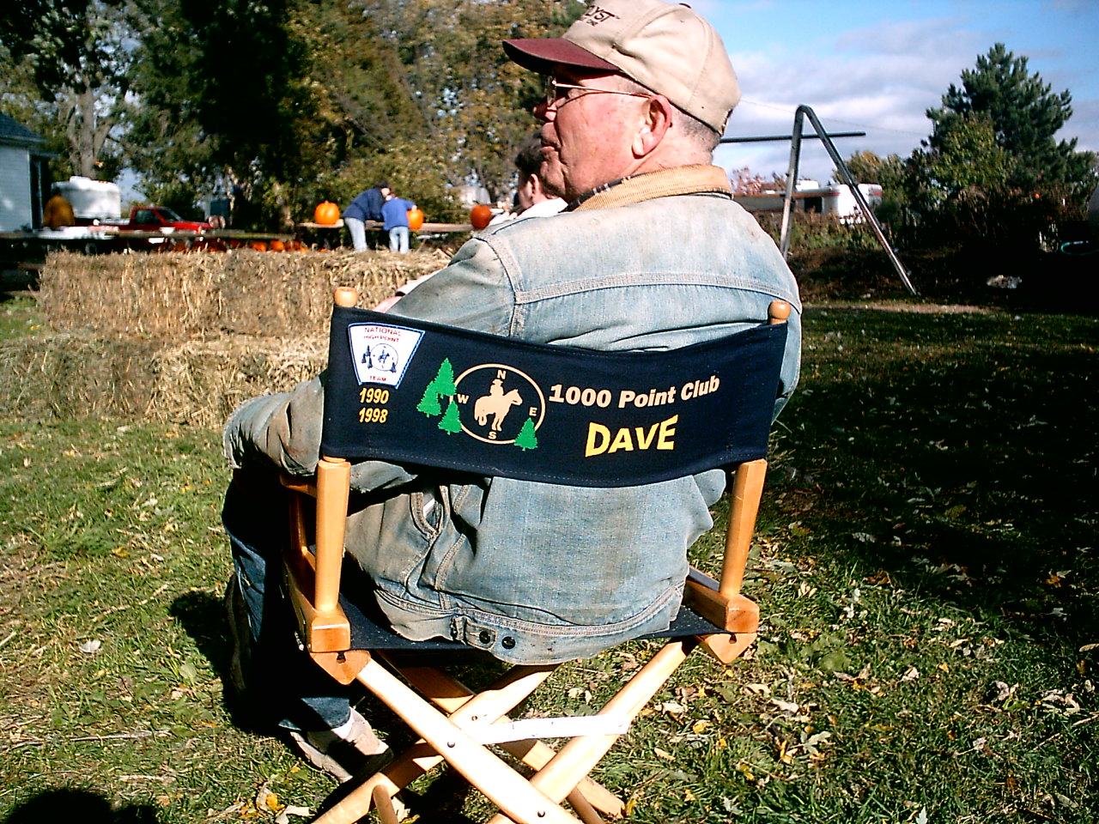

Slide 74
Notes:
Some of the awards available – Rookie of the year and the award for having managed 5 rides.

Slide 75
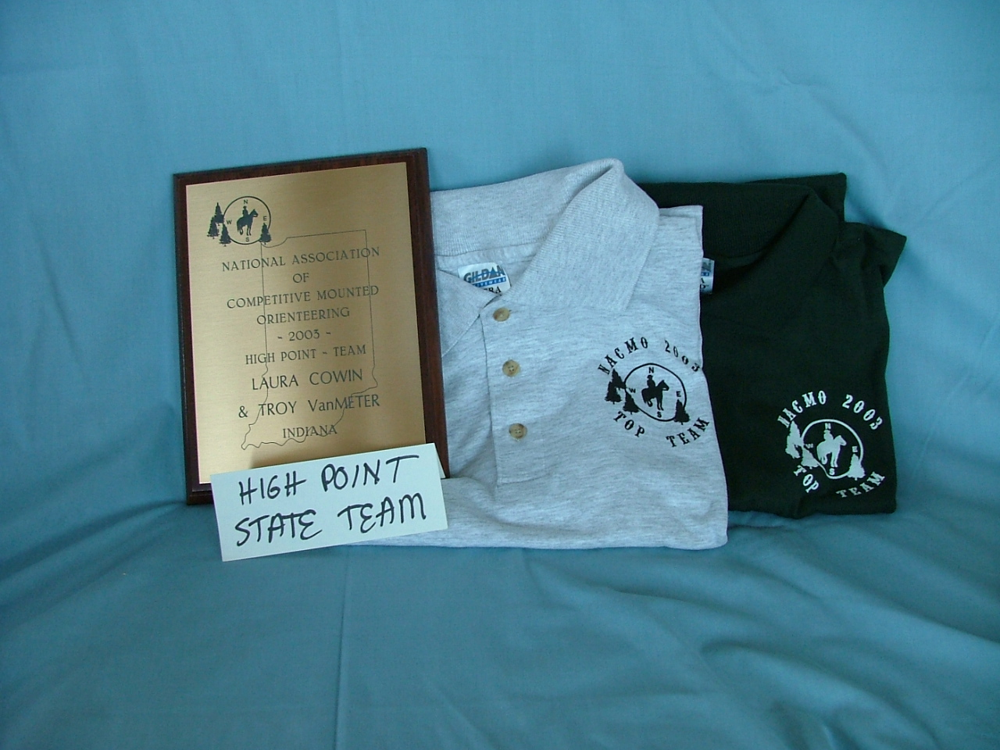
Notes:
Plaques and shirts for top team awards are popular.

Slide 76
Notes:
Horse awards may be lead ropes, hay bags, or other horsie equipment.

Slide 77
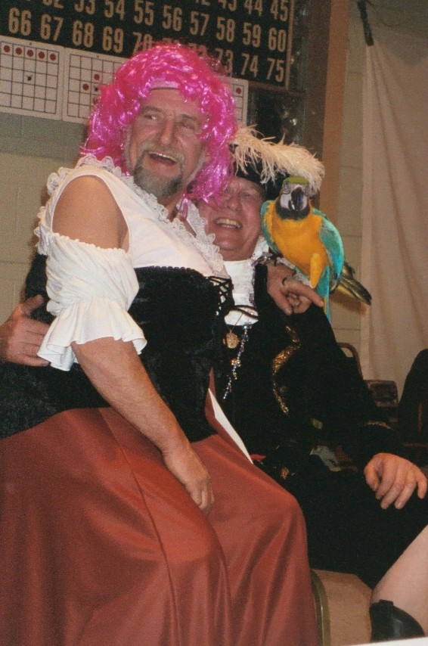
Notes:
Silliness is a big part of our annual awards banquet also.

Slide 78
Notes:
Here are some of the parks where we have had CMO rides in IL

Slide 79
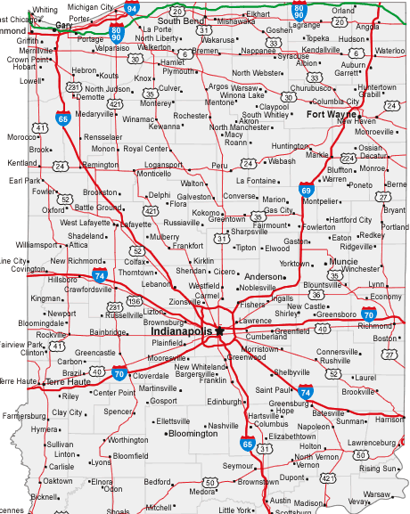
v
vv
v
Notes:
And Indiana

Slide 80
Come join us!
Notes:
Thanks for letting us share our sport with you. Come play with us!

Slide 81
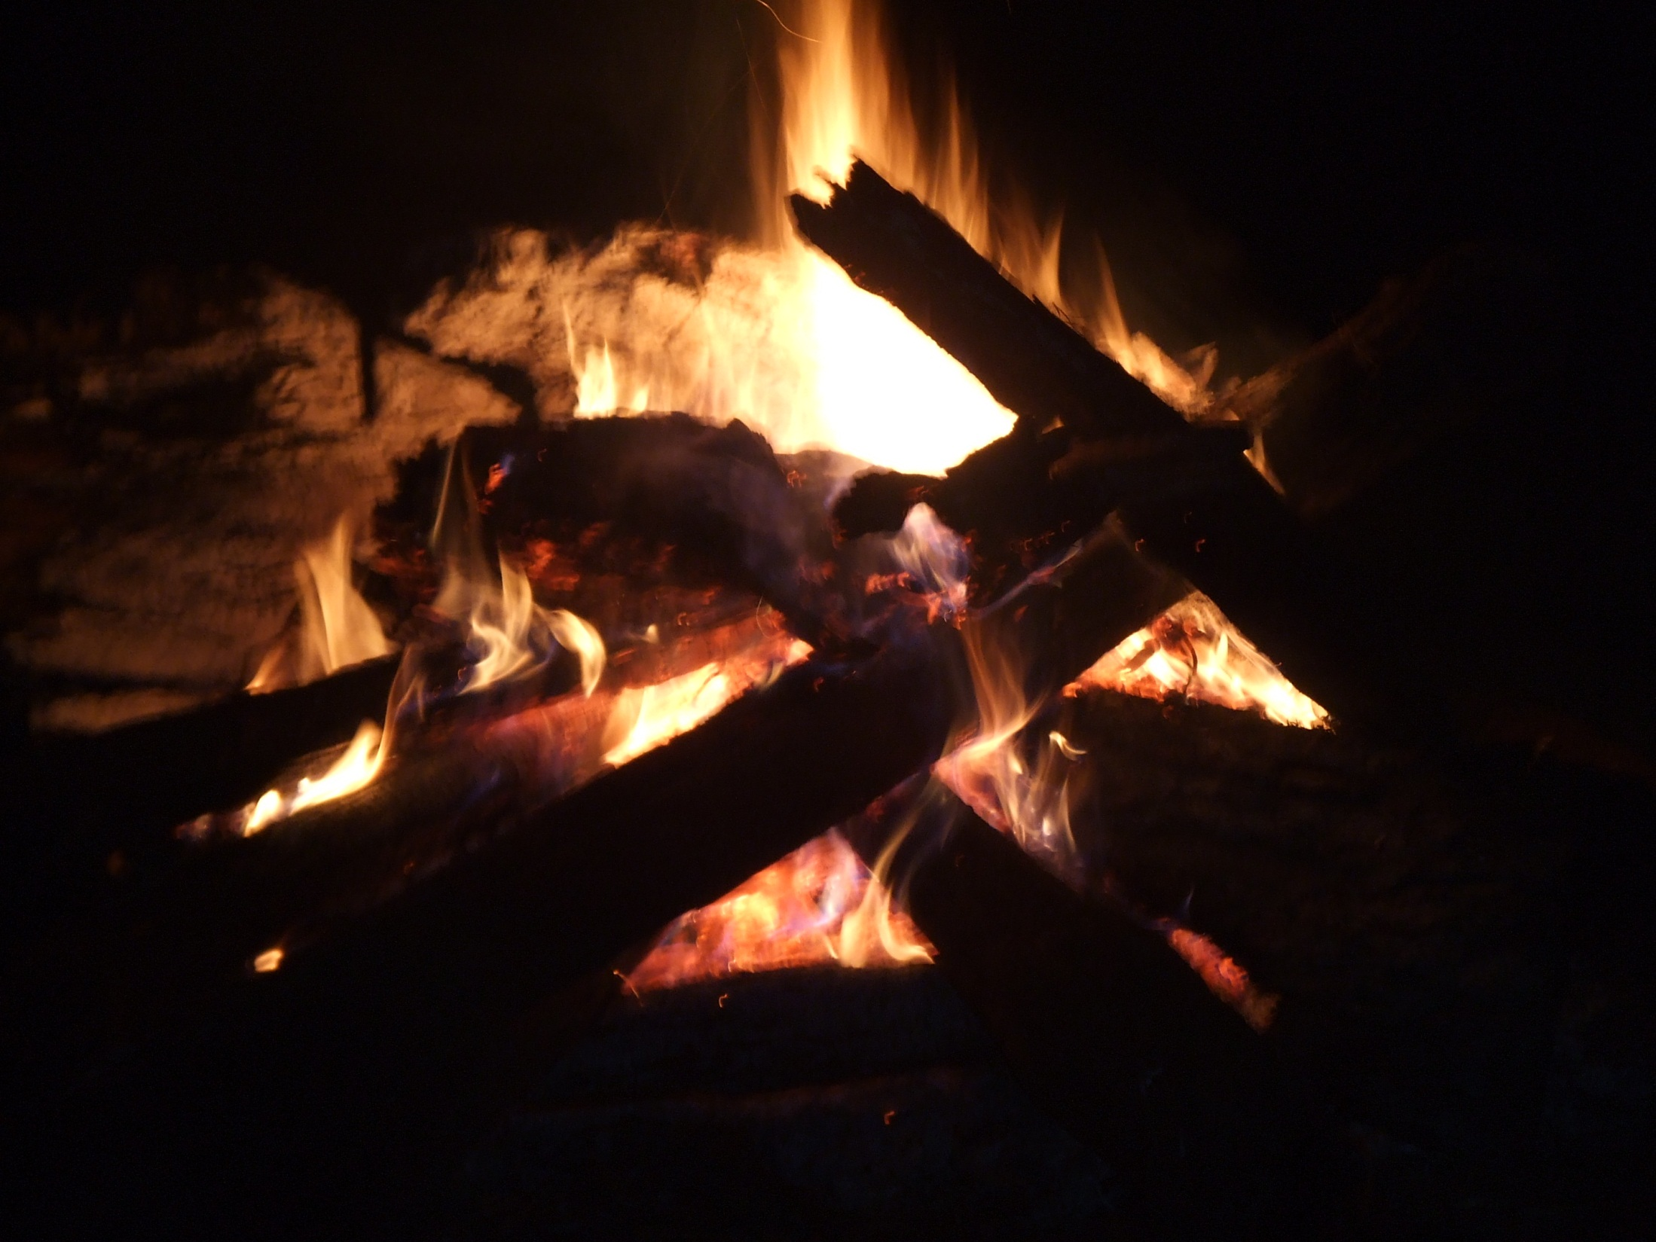
Website: www.nacmo.org FB: IN/IL CMO
Notes:
We’ll keep the campfire lit up for you!

